Slide 1
Ekonomia algorytmiczna 2025/26 – warunki zaliczenia
Każdy uczestnik musi w ciągu roku akademickiego wygłosić jedną prezentację:
  W semestrze zimowym studenci 2. roku prezentują postępy pracy magisterskiej
  W semestrze letnim studenci 1. roku wygłaszają prezentację na temat jakiejś publikacji naukowej
  Tydzień przed prezentacją należy przesłać temat, abstract i slajdy
  Po prezentacji krótki feedback
Obecność na zajęciach:
  Do pięciu nieobecności na semestr
  Lista sprawdzana na początku zajęć
Warunek formalny zaliczenia:
  Na 1. roku: zatwierdzenie tematu pracy magisterskiej
  Na 2. roku: złożenie pracy magisterskiej

Slide 2

  Hiding from Artificial Intelligence
  Marcin Waniek

Slide 3
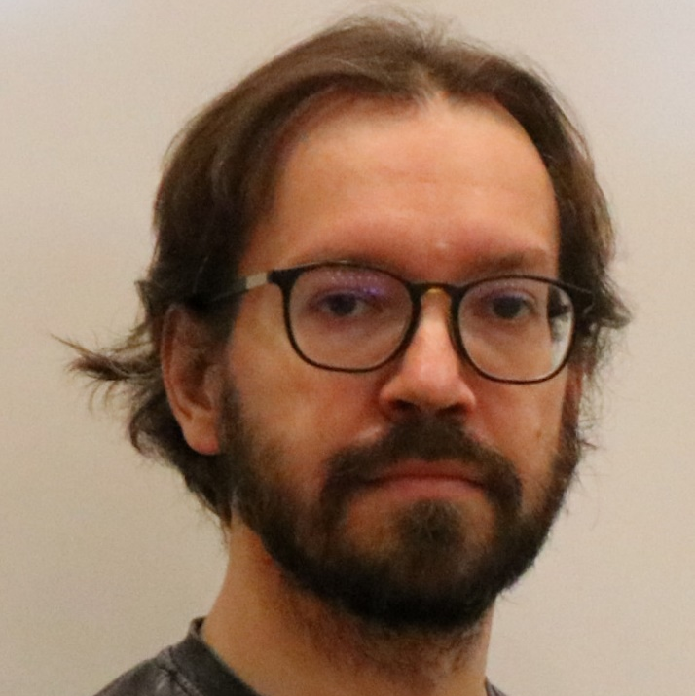
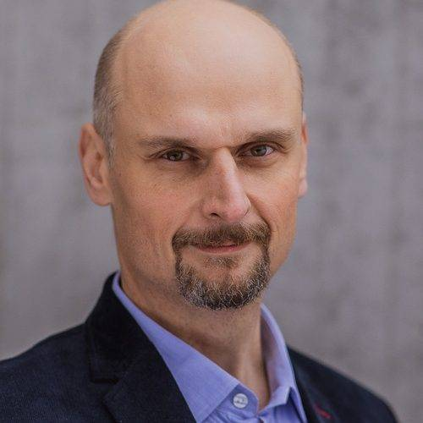


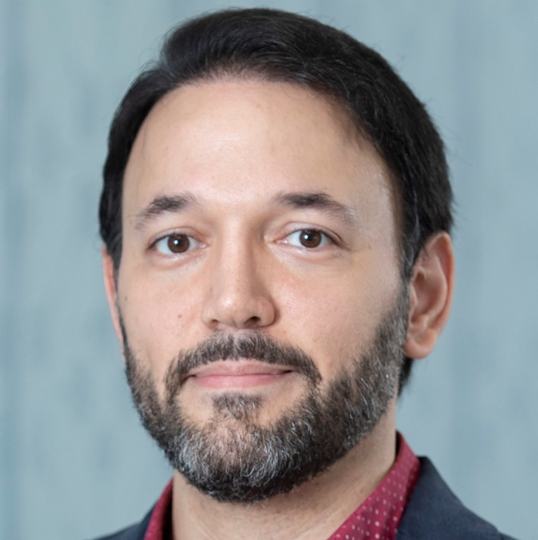

Who am I?
June 2017
Defended a PhD dissertation at MIMUW
Thesis: Hiding in Social Networks
Main supervisor: Piotr Faliszewski
Auxilliary supervisor: Tomasz Michalak
July 2017 – February 2019
Post-Doctoral Fellow
at Khalifa University
Supervisor: Aamena Alshamsi
February 2019 – September 2023
Post-Doctoral Associate
at New York University Abu Dhabi
Supervisor: Talal Rahwan

Slide 4
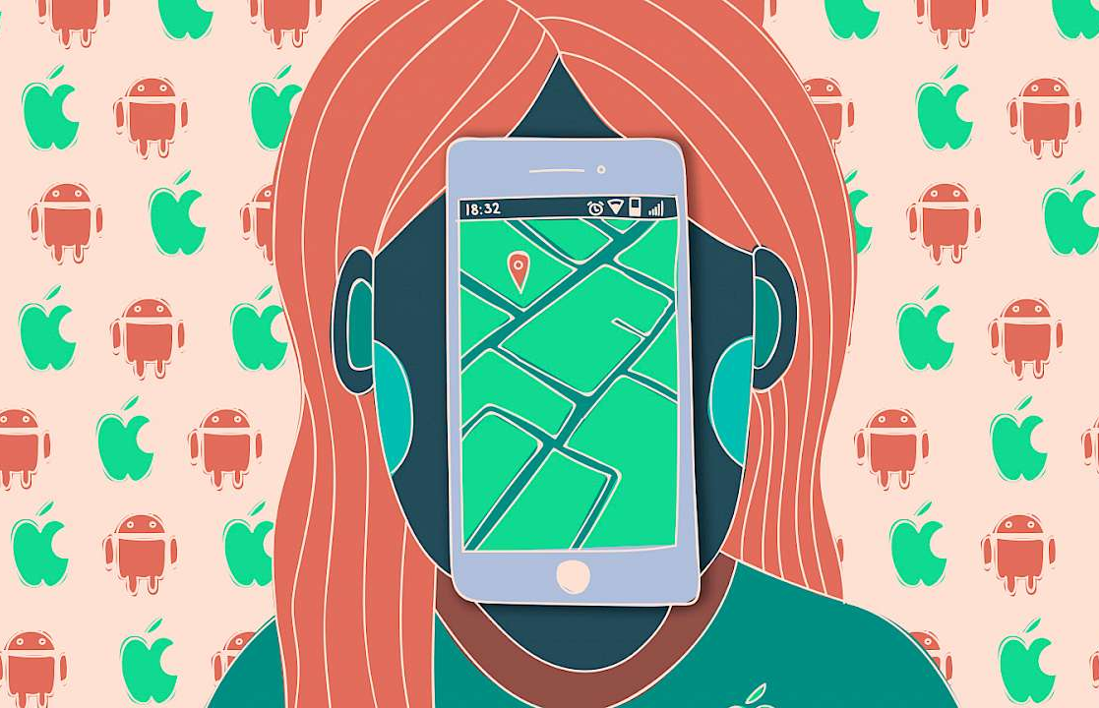

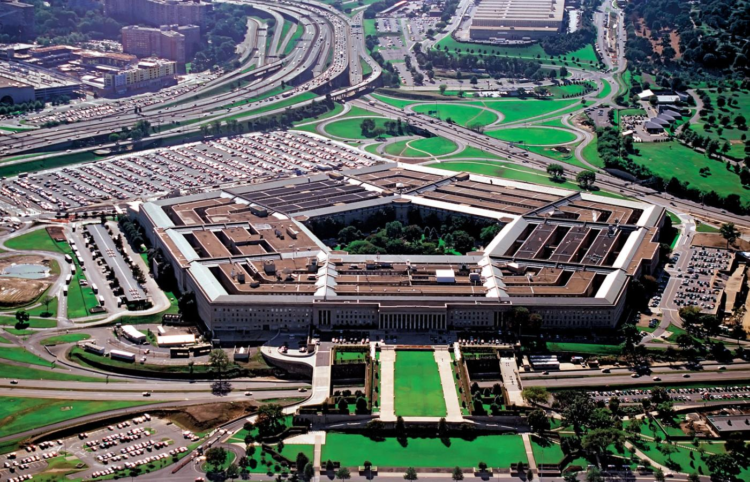
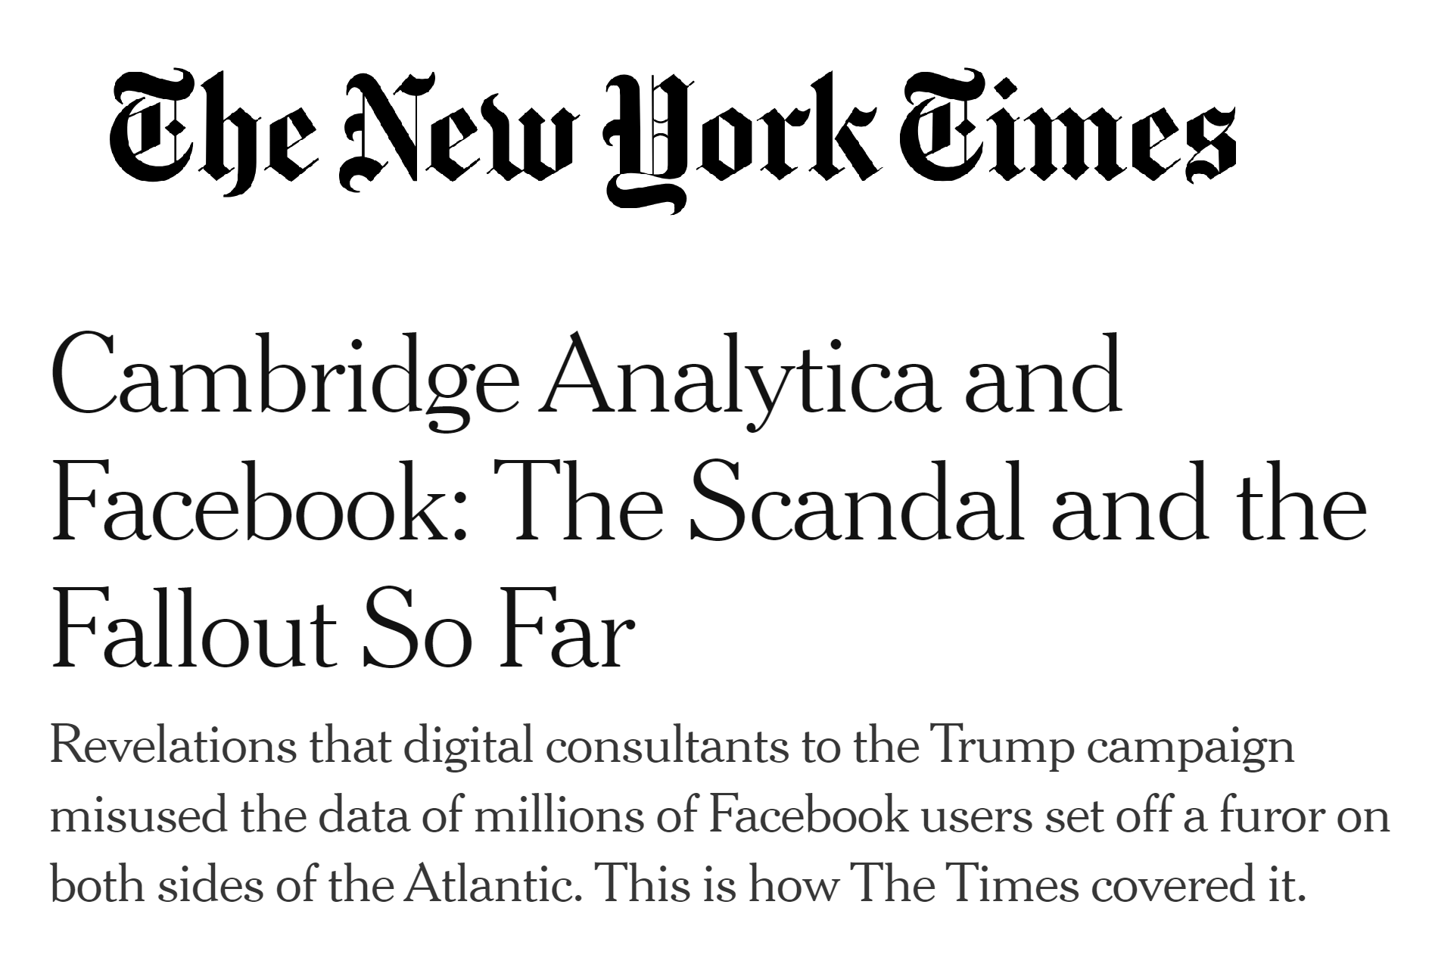
Hiding from artificial intelligence
It is getting increasingly difficult to live without leaving digital traces…
…that can be scrutinized by AI algorithms.
The literature assumes
that the responsibility lies
with a central authority…
…which is prone to failure.

Slide 5

The general idea of this line of research
How important is the evader?
Does the evader have any undisclosed relationships?
What is the evader’s political orientation?
The evader
The seeker

Slide 6
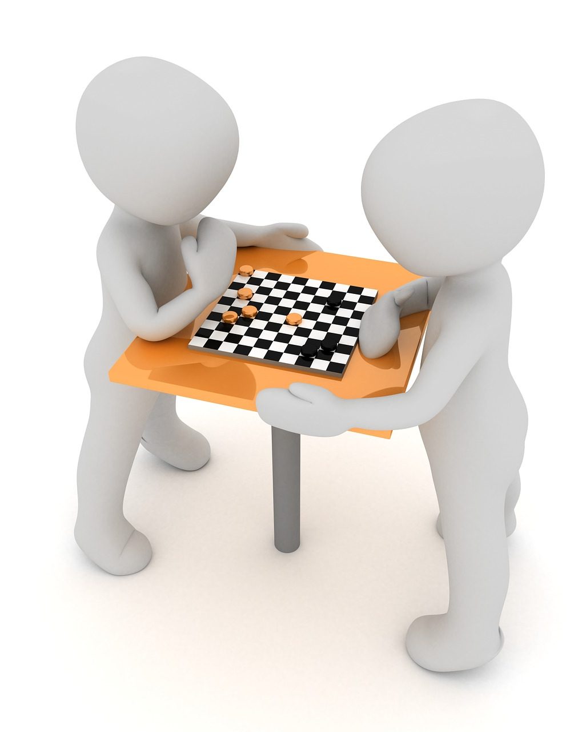
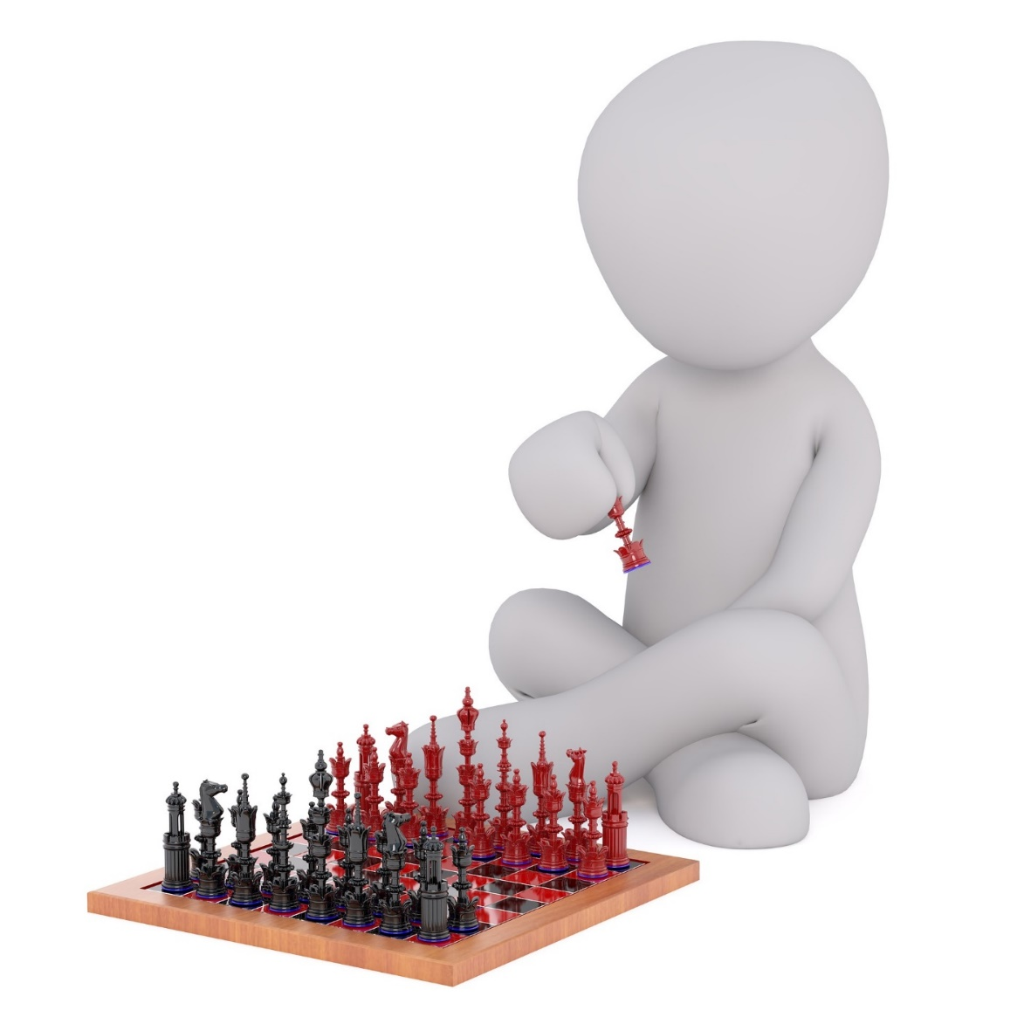
Existing literature
Our line of research
The evader
The seeker
The evader
The seeker

Slide 7
What am I going to be talking about?
Hiding importance from centrality measures
Hiding group membership from community detection algorithms
Hiding undisclosed relationships from link prediction algorithms
Hiding the origin of a social diffusion from source detection algorithms
Hiding opinions from stance detection algorithms

Slide 8

  Hiding from
  centrality measures

Slide 9












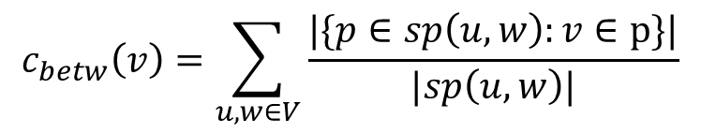






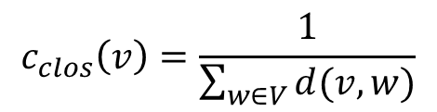







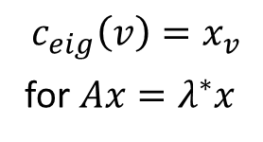
Centrality
Centrality measures – methods of evaluating the relative importance of nodes.
$$\frac{1}{16}$$
Degree centrality (the most important node is the one with the greatest number of friends)
Closeness centrality (the most important node is the one who is close to everyone else)
Betweeness centrality (the most important node is the one who controls the flow of information)
Eigenvector centrality (the most important node is the one with important friends)
$$\frac{1}{16}$$
$$0$$
$$0$$
$$3$$
$$3$$
A
B
$$\frac{1}{12}$$
C
D
$$\frac{1}{12}$$
$$4$$
$$4$$
$$4$$
$$4$$
$$\frac{1}{11}$$
$$12$$
E
$$3$$
$$\frac{1}{13}$$
$$3$$
F
$$10$$
G
H
$$0$$
$$0$$
$$\frac{1}{18}$$
$$\frac{1}{18}$$
$$2$$
$$2$$
$$c_{clos}\left(v\right)=\frac{1}{\sum_{w∈V}{d(v,w)}}$$
$$c_{betw}\left(v\right)=\sum_{u,w∈V}{\frac{|\{p∈sp\left(u,w\right):v∈p\}|}{|sp\left(u,w\right)|}}$$
$$c_{eig}\left(v\right)=x_{v}$$
for $Ax=λ^{∗}x$
$$c_{degr}\left(v\right)=|N\left(v\right)|$$

Slide 10
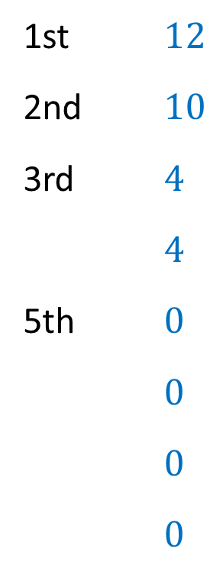
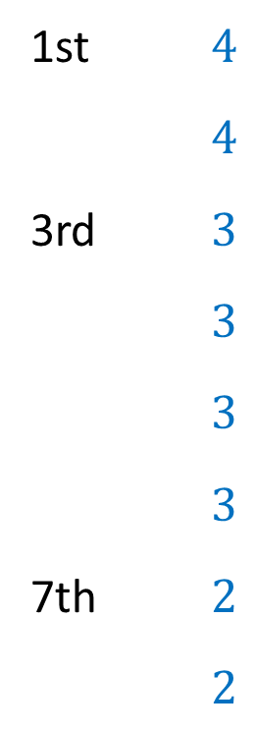
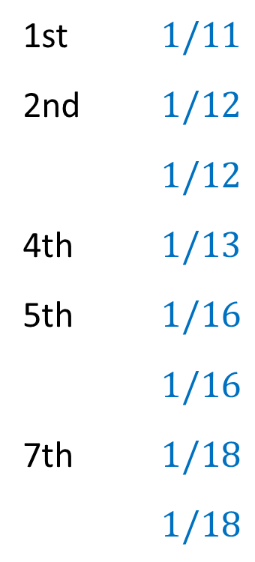
Centrality
Centrality measures – methods of evaluating the relative importance of nodes.
Degree Closeness Betweenness
$$3$$
$$3$$
A
B
1st $4$
$4$
3rd $3$
$3$
$3$
$3$
7th $2$
$2$
1st $1/11$
2nd $1/12$
$1/12$
4th $1/13$
5th $1/16$
$1/16$
7th $1/18$
$1/18$
1st $12$
2nd $10$
3rd $4$
$4$
5th $0$
$0$
$0$
$0$
A
B
E
E
C
D
C
F
C
D
$$4$$
$$4$$
E
$$3$$
D
C
E
$$3$$
F
D
F
F
G
H
A
A
G
H
$$2$$
$$2$$
B
B
G
G
H
H

Slide 11










Independent cascade influence model
$$v^{∗}$$
The process begins with only the source node being active.
Every edge in the network is marked with the probability of activation.
Every newly activated node has a single chance to activate each of his neighbors.
The influence of the source node on the network is measured as the expected number of activated nodes.
$$0.5$$
$$0.5$$
$$0.5$$
$$0.5$$
$$0.5$$
$$0.5$$
$$0.5$$
$$0.5$$
$$0.5$$

Slide 12


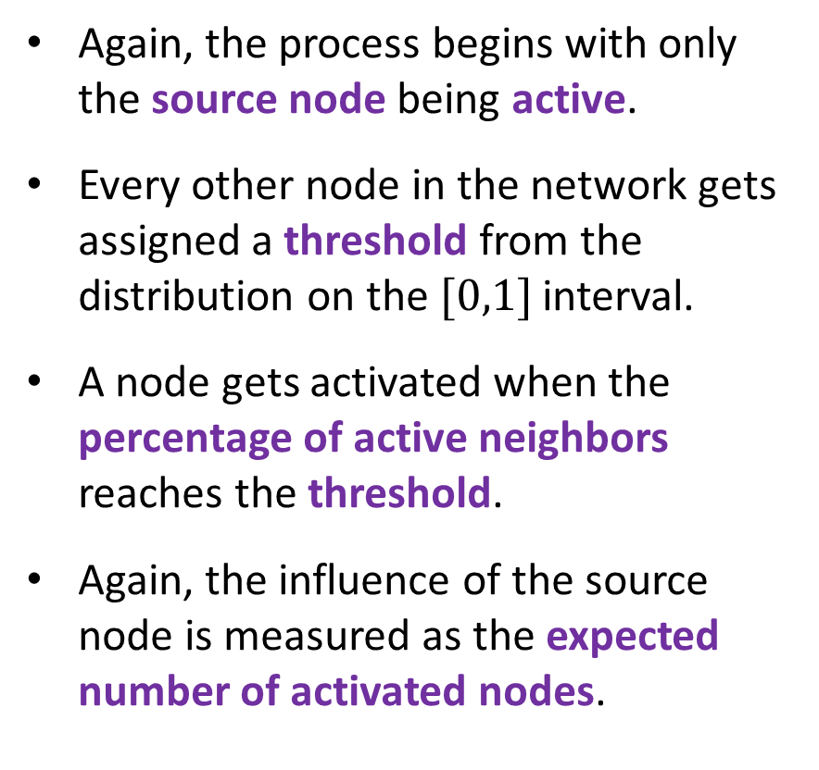



Linear threshold influence model
$$v^{∗}$$
Again, the process begins with only the source node being active.
Every other node in the network gets assigned a threshold from the distribution on the $[0,1]$ interval.
A node gets activated when the percentage of active neighbors reaches the threshold.
Again, the influence of the source node is measured as the expected number of activated nodes.
$$1/3$$
$$2/4$$
$$3/4$$
$$2/3$$
$$1/2$$

Slide 13
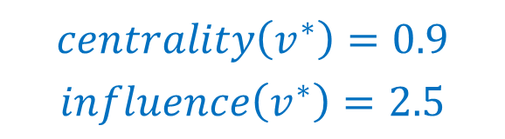
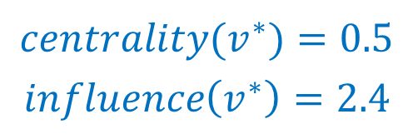

Hiding from centrality measures
Choose how to spend the budget, i.e., which edge(s) to add and which to remove
$$v^{∗}$$
$$v^{∗}$$
$$centrality\left(v^{∗}\right)=0.9$$
$$influence\left(v^{∗}\right)=2.5$$
$$centrality(v^{∗})=0.5$$
$$influence\left(v^{∗}\right)=2.4$$
Edge that can be added
Edge that can be removed
M Waniek, T Michalak, M Wooldridge, T Rahwan. Hiding individuals and communities in a social network. Nature Human Behaviour (2018)

Slide 14
Complexity of finding an optimal solution
Centrality | Absolute values | Ranking
Degree
Closeness
Betweenness
Centrality | Absolute values | Ranking
Degree | P | NP-complete
Closeness | NP-complete | NP-complete
Betweenness | NP-complete | NP-complete
Influence | Rebuild local | Rebuild sum
Independent cascade | NP-hard | NP-hard
Linear threshold | NP-hard | NP-hard
M Waniek, T Michalak, M Wooldridge, T Rahwan. Hiding individuals and communities in a social network. Nature Human Behaviour (2018)
M Waniek, T Michalak, M Wooldridge, T Rahwan. How members of covert networks conceal the identities of their leaders. ACM TIST (2021)

Slide 15

NP-hardness of decreasing closeness value
$$v^{∗}$$
Finding Hamiltonian cycle problem
Decreasing closeness centrality value problem
M Waniek, T Michalak, M Wooldridge, T Rahwan. Hiding individuals and communities in a social network. Nature Human Behaviour (2018)

Slide 16



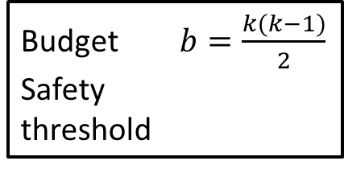







NP-hardness of decreasing degree ranking
$$v^{∗}$$
$$v_{2}$$
$$v_{2}$$
$$v_{1}$$
$$v_{3}$$
$$v_{1}$$
$$v_{3}$$
$$v_{4}$$
$$v_{4}$$
Budget $b=\frac{k(k−1)}{2}$
Safety
threshold
$$ω=k$$
Finding k-clique problem
Decreasing degree centrality ranking problem
M Waniek, T Michalak, M Wooldridge, T Rahwan. How members of covert networks conceal the identities of their leaders. ACM TIST (2021)

Slide 17
Our heuristic ROAM (Remove One, Add Many)
Remove an edge between you and one of your neighbours
Add some edges between your neighbours
$$v^{∗}$$
$$v^{∗}$$
$$v^{∗}$$
$$v^{∗}$$
M Waniek, T Michalak, M Wooldridge, T Rahwan. Hiding individuals and communities in a social network. Nature Human Behaviour (2018)

Slide 18

What if criminal organizations would use such evasion techniques?

Slide 19
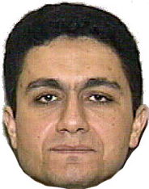

Hiding in WTC 9/11 terrorist network
26
33
36
32
Original network
1st in Degree centrality ranking
1st in Closeness centrality ranking
1st in Betweenness centrality ranking
IC influence = 2.55
LT influence = 6.44
34
21
30
35
9
10
11
25
7
After one execution of ROAM
3rd in Degree centrality ranking
2nd in Closeness centrality ranking
5th in Betweenness centrality ranking
IC influence = 2.39
LT influence = 6.72
We run ROAM heuristic
8
29
24
Mohamed Atta
One of the ringleaders behind the attack
22
12
16
27
28
23
We run ROAM heuristic
one more time
After two executions of ROAM
5th in Degree centrality ranking
4th in Closeness centrality ranking
11th in Betweenness centrality ranking
IC influence = 2.21
LT influence = 6.90
2
1
15
13
18
4
5
14
31
3
19
20
17
M Waniek, T Michalak, M Wooldridge, T Rahwan. Hiding individuals and communities in a social network. Nature Human Behaviour (2018)

Slide 20


Building a network from scratch
What if we do not want to reshape an existing network, but rather construct a new one from scratch?
Assume we have a group of network leaders…
… and a group of followers.
We want to connect them into a network so that:
  there are no leaders in top centrality ranking positions,
  the leaders can effectively communicate with the rest of the network.
M Waniek, T Michalak, M Wooldridge, T Rahwan. How members of covert networks conceal the identities of their leaders. ACM TIST (2021)

Slide 21
















The captains network
$$l_{1}$$
We start with a group of leaders connected into a clique.
To each leader we assign a group of captains.
We connect the captains into a full k-partite graph.
Each of the remaining nodes gets connected with one captain from each group.
$$l_{3}$$
$$l_{2}$$
$$c_{1,1}$$
$$c_{2,1}$$
$$c_{3,1}$$
$$…$$
$$…$$
$$…$$
$$c_{1,k}$$
$$c_{2,k}$$
$$c_{3,k}$$
$$…$$
$$x_{1}$$
$$x_{2}$$
$$x_{m}$$
In this network every captain is guaranteed to have greater degree, closeness and betweenness centrality than any of the leaders.
M Waniek, T Michalak, M Wooldridge, T Rahwan. How members of covert networks conceal the identities of their leaders. ACM TIST (2021)

Slide 22
Multilayer networks
Facebook
A
A
B
C
B
C
E
D
E
A
A
Email
C
B
C
D
E
D
E
Means of communication
Facebook
Email
WhatsApp
WhatsApp
A
B
D
E
Notes:
Diagonal couplings

Slide 23




Local centrality in multilayer networks
Local approach – apply standard centrality measure in each layer separately.
$$α$$
1. D
2. B
3. A
…
10. G
D
G
I
A
J
$$c$$
H
B
E
1. A
2. C
3. B
…
10. H
11. K
K
F
D
G
I
1. C
2. H
3. B
…
10. D
J
$$c$$
H
A
B
E
$$β$$
C
F

Slide 24
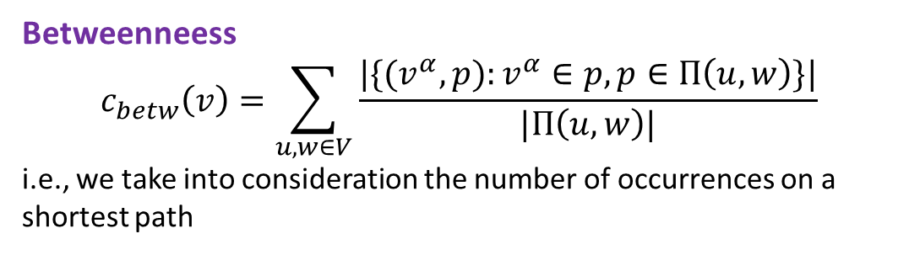
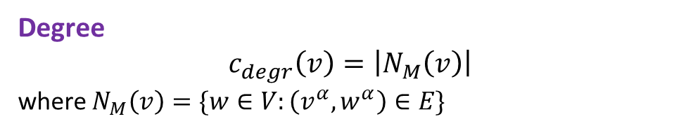
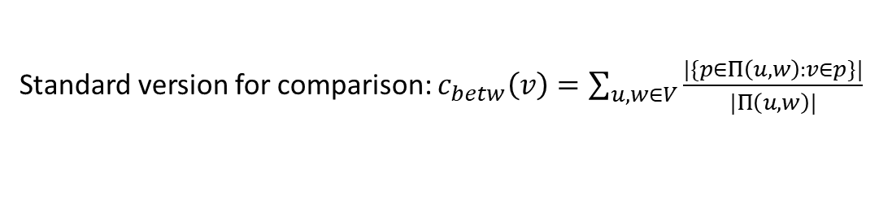


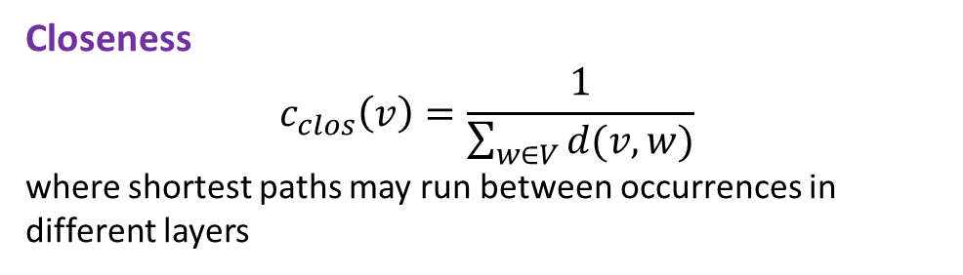

Global centrality in multilayer networks
Global approach – treat network as a whole. Requires adjustments in centrality definitions.
Degree
$$c_{degr}\left(v\right)=\left|N_{M}\left(v\right)\right|$$
where $N_{M}\left(v\right)=\{w∈V:\left(v^{α},w^{α}\right)∈E\}$
$$α$$
D
G
I
A
J
H
B
E
Closeness
$$c_{clos}\left(v\right)=\frac{1}{\sum_{w∈V}{d(v,w)}}$$
where shortest paths may run between occurrences in different layers
K
F
D
G
I
J
Betweenneess
$$c_{betw}\left(v\right)=\sum_{u,w∈V}{\frac{|\{(v^{α},p):v^{α}∈p,p∈Π\left(u,w\right)\}|}{|Π\left(u,w\right)|}}$$
i.e., we take into consideration the number of occurrences on a shortest path
H
A
B
E
$$β$$
C
F
$$N_{M}\left(A\right)=\left\{B,C,D,E,F\right\}$$
Standard version for comparison: $c_{betw}\left(v\right)=\sum_{u,w∈V}{\frac{|\{p∈Π\left(u,w\right):v∈p\}|}{|Π\left(u,w\right)|}}$
Notes:
Contributes more to score of G than to score of H.

Slide 25
Hiding in multilayer networks
Facebook
Facebook
D
G
I
D
G
I
A
J
A
J
H
H
B
E
B
E
K
Choose the layer of contact for each node
K
F
F
D
G
I
D
G
I
J
J
H
H
A
B
E
A
B
E
Email
C
F
Email
C
F
A
The evader
The problem is NP-complete.
X
Nodes that evader wants to maintain contact with
Heuristic: contact with densely connected group of friends in each layer.
M Waniek, T Michalak, T Rahwan. Hiding in multilayer networks. AAAI (2020)

Slide 26



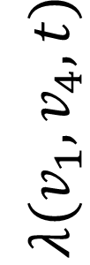


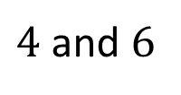











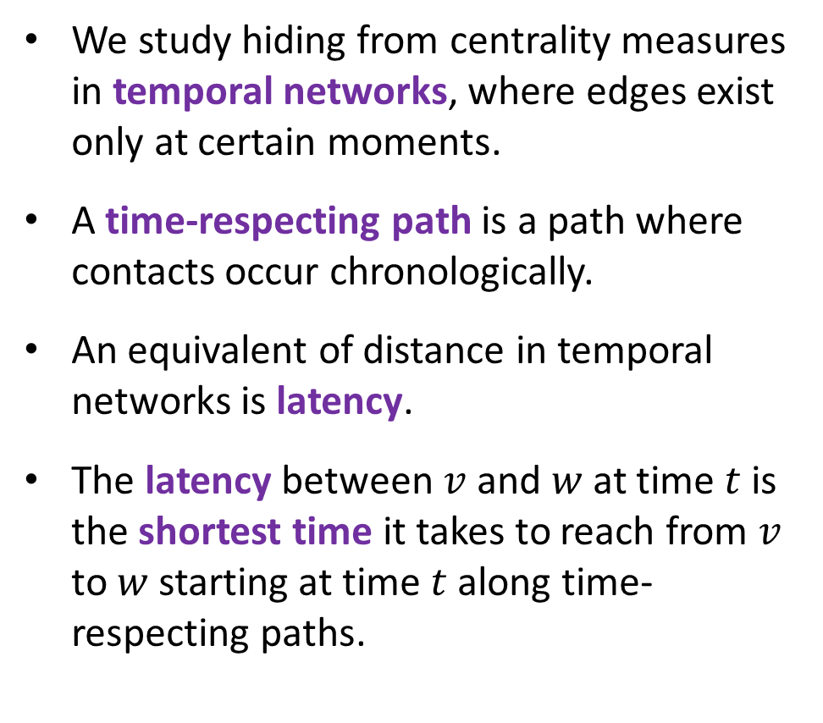







Temporal networks
$$v_{2}$$
We study hiding from centrality measures in temporal networks, where edges exist only at certain moments.
A time-respecting path is a path where contacts occur chronologically.
An equivalent of distance in temporal networks is latency.
The latency between $v$ and $w$ at time $t$ is the shortest time it takes to reach from $v$ to $w$ starting at time $t$ along time-respecting paths.
$$1$$
$4$ and $6$
$$v_{1}$$
$$6$$
$$v_{4}$$
$$3$$
$$v_{3}$$
$$5$$
$$5$$
$$λ(v_{1},v_{4},t)$$
$$4$$
$$3$$
$$2$$
$$1$$
$$0$$
$$0$$
$$1$$
$$2$$
$$3$$
$$4$$
$$5$$
$$6$$
$$7$$
$$t$$

Slide 27
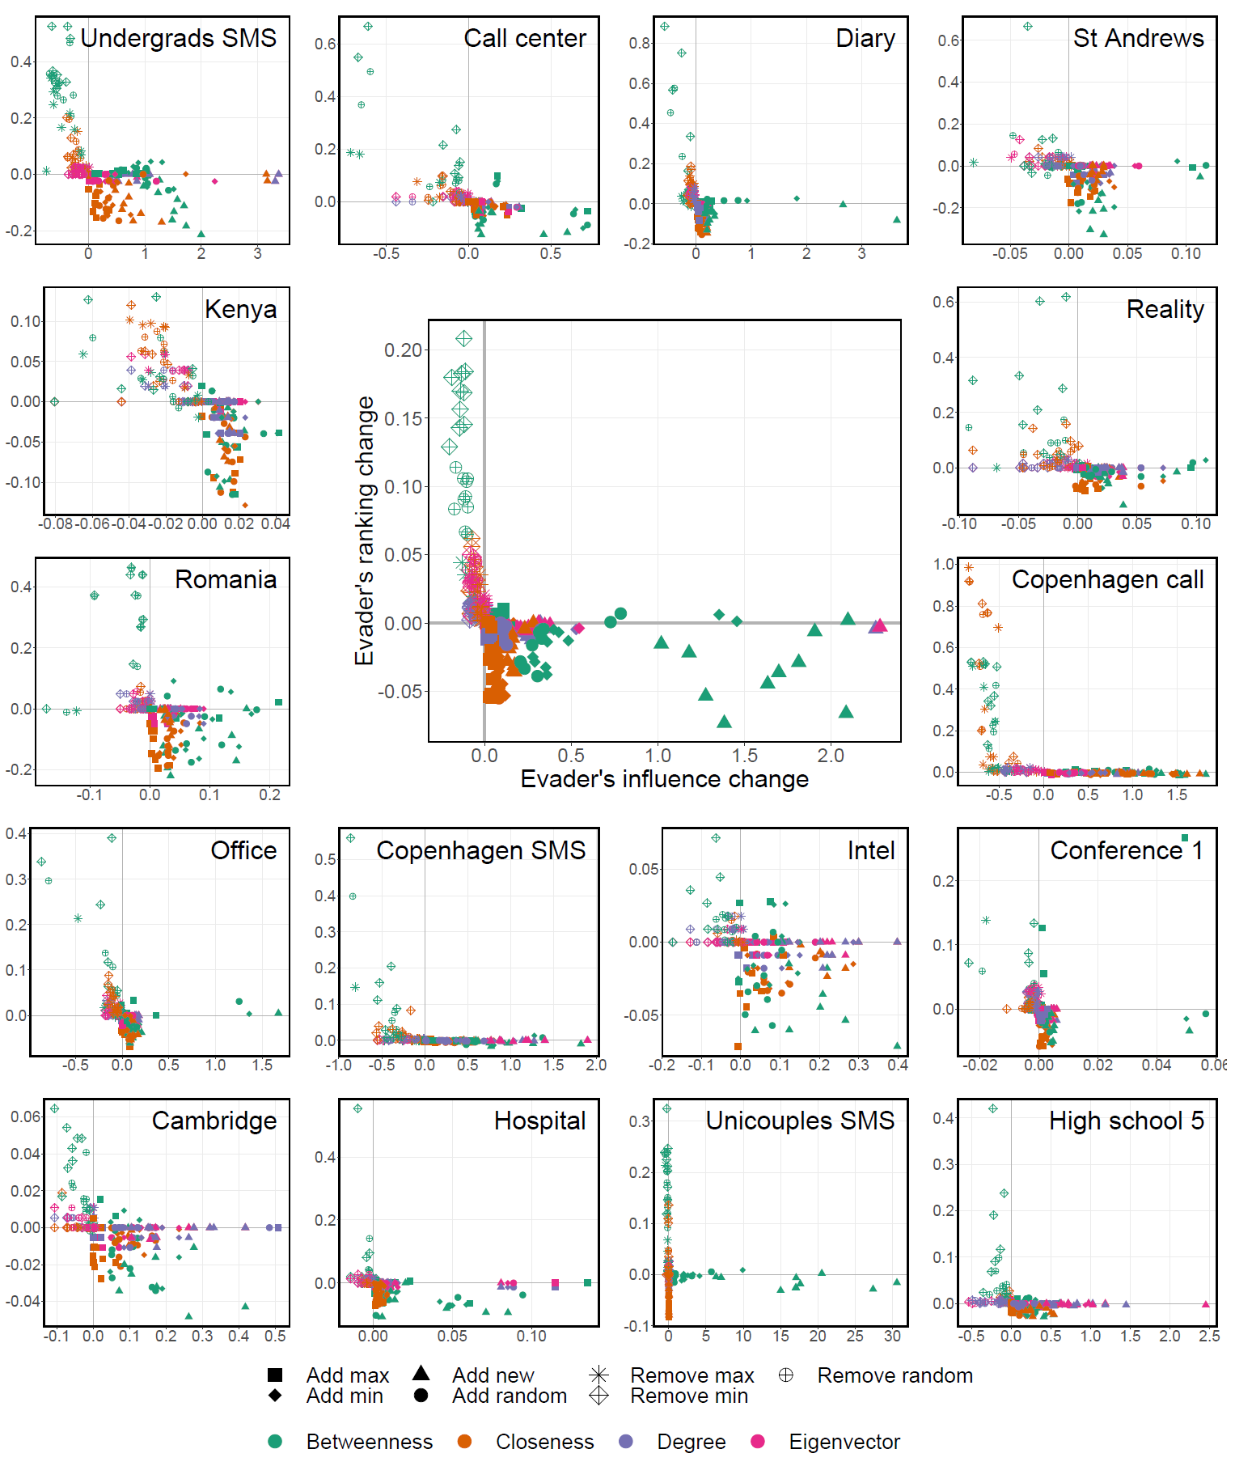
Hiding heuristics in temporal networks
Finding an optimal way to hide from temporal centralities is NP-complete.
Instead, we tested a number of heuristic solutions.
Removing existing contacts is significantly more effective in avoiding detection than adding new contacts.
On the other hand, adding new contacts improves the influence.
M Waniek, P Holme, T Rahwan. Hiding in temporal networks. IEEE Transactions on Network Science and Engineering (2022)

Slide 28
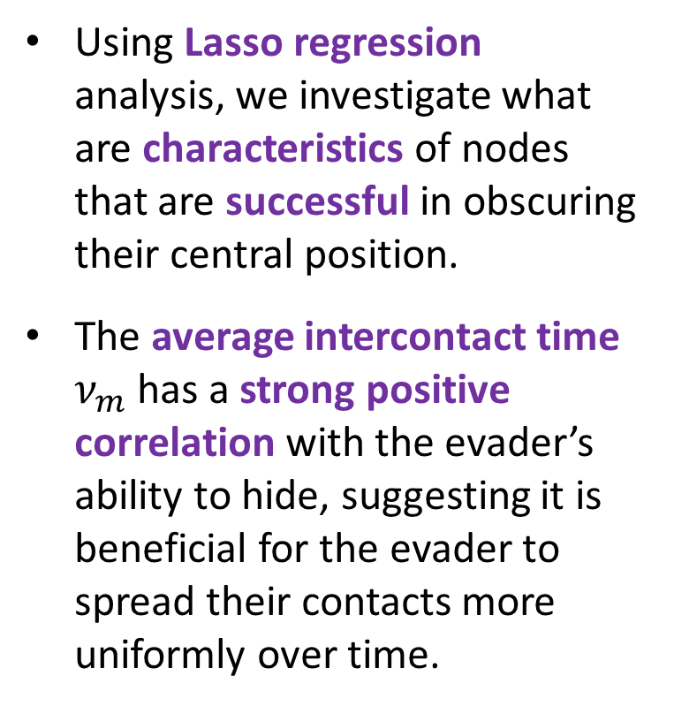
Successful hiding in temporal networks
Using Lasso regression analysis, we investigate what are characteristics of nodes that are successful in obscuring their central position.
The average intercontact time $ν_{m}$ has a strong positive correlation with the evader’s ability to hide, suggesting it is beneficial for the evader to spread their contacts more uniformly over time.
M Waniek, P Holme, T Rahwan. Hiding in temporal networks. IEEE Transactions on Network Science and Engineering (2022)

Slide 29




Project idea #1 Temporal network of scientists
2015,
2017-2023
2013-2016,
2018, 2019
Research question
How important events in a scientist’s career affect their centrality?
Bedoor AlShebli
New York University Abu Dhabi

Slide 30
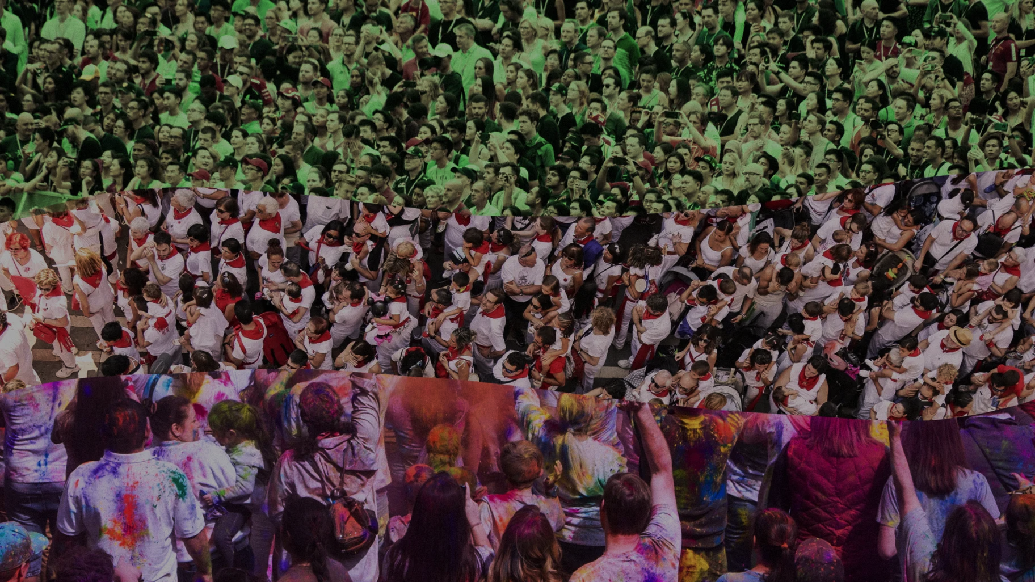
  Hiding from
  community detection

Slide 31



Community detection algorithms
The term community is usually understood as a group of closely cooperating individuals.
Community detection algorithms divide the set of nodes of the network into communities.
Such division is called a community structure.
$$C_{2}$$
$$C_{3}$$
$$C_{1}$$

Slide 32



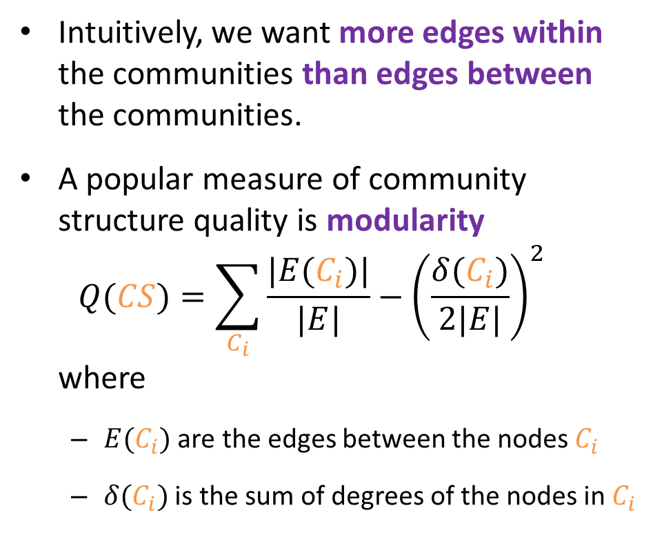





Measuring the quality of community structure
Intuitively, we want more edges within the communities than edges between the communities.
A popular measure of community structure quality is modularity
$Q(CS)=\sum_{C_{i}}{\frac{|E(C_{i})|}{|E|}−{\left(\frac{δ(C_{i})}{2|E|}\right)}^{2}}$
where
  $E(C_{i})$ are the edges between the nodes $C_{i}$
  $δ(C_{i})$ is the sum of degrees of the nodes in $C_{i}$
$$C_{1}^{′}$$
$$C_{2}$$
$$C_{2}^{′}$$
$$C_{3}^{′}$$
$$C_{3}$$
$$C_{1}$$
$$Q(CS)=0.42875$$
$$Q\left(CS^{′}\right)=0.08625$$

Slide 33
Community detection algorithms
Betweenness - iteratively remove edges belonging to many shortest paths
Greedy - merge communities that provide greatest modularity gain
Walktrap - based on a tendency of random walks to stay within the same community
Eigenvector - recursively split nodes into two based on the eigenvector signs
Louvain – merge locally optimal community into a single node
Infomap - based on compressing a description of the probability flow
Spinglass - interpreting each node as an atom in a magnet, assign community based on spin
A
E
C
D
B
F
B
A
B
C
D
E
F
A
B
C
D
E
F
A
B
C
D
E
F
A
B
C
D
E
F
A
B
C
D
E
F
A
B
C
D
E
F

Slide 34
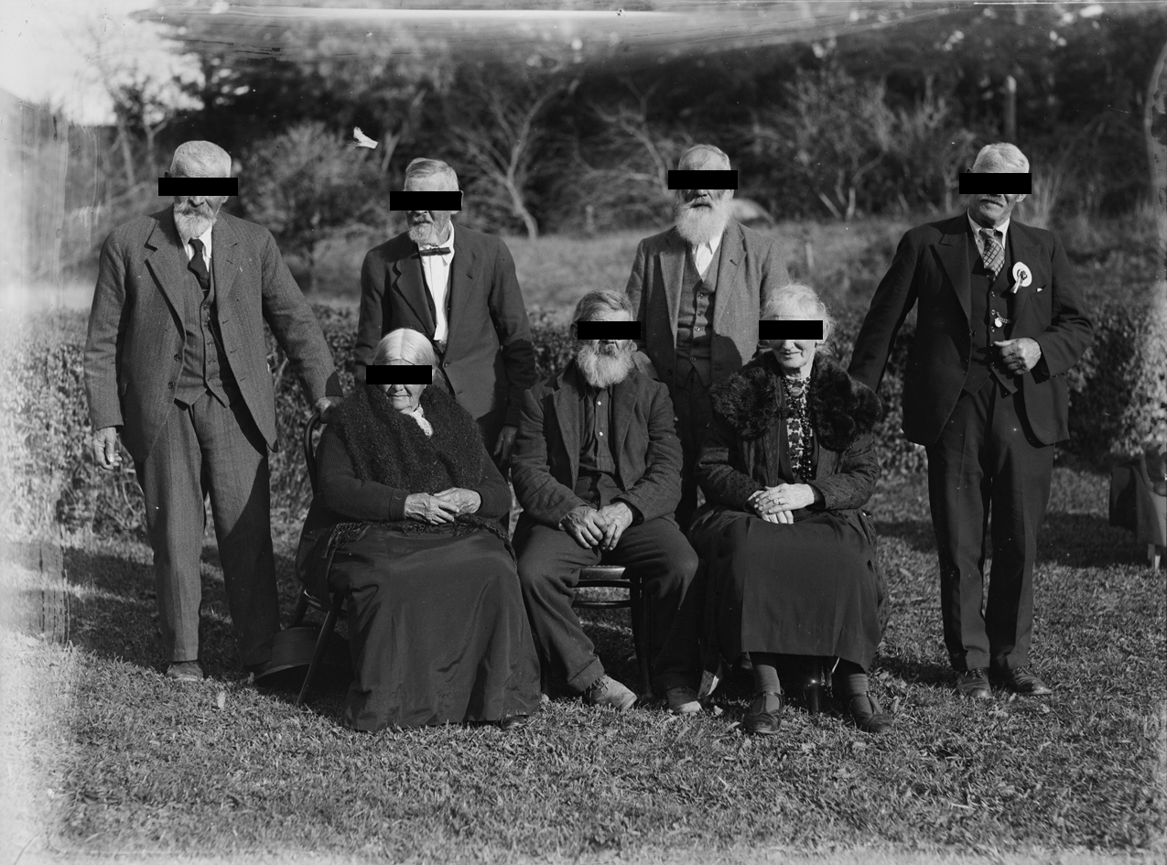
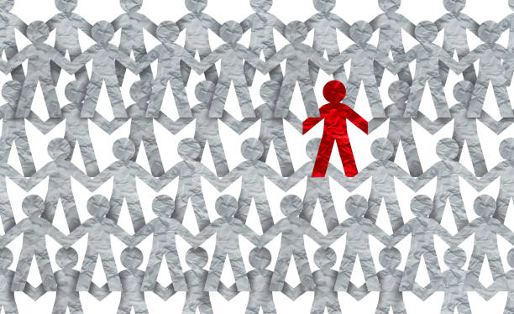
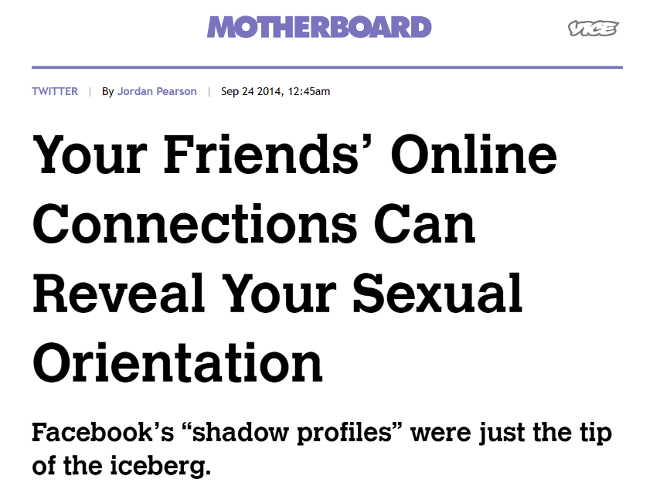
Hiding from community detection
Some people might prefer not to disclose membership of certain groups…
…e.g., minorities persecuted based on a ethnic background.
Community detection can also be used to infer other kinds of sensitive information.
M Waniek, T Michalak, M Wooldridge, T Rahwan. Hiding individuals and communities in a social network. Nature Human Behaviour (2018)

Slide 35


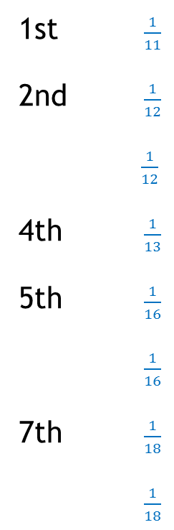
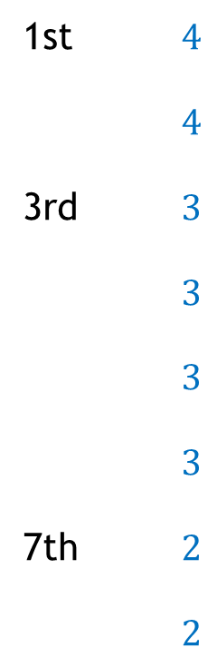


Hiding from community detection
$$C_{2}$$
$$C_{2}^{′}$$
Choose how to spend the budget, i.e., which edge(s) to add and which to remove
$$C_{1}^{′}$$
$$C_{3}$$
$$C_{1}$$
$$C_{3}^{′}$$
Additional requirement:
We want to maintain communication structure of the group
Member of the hiding group
Edge that can be added
Edge that can be removed
M Waniek, T Michalak, M Wooldridge, T Rahwan. Hiding individuals and communities in a social network. Nature Human Behaviour (2018)

Slide 36

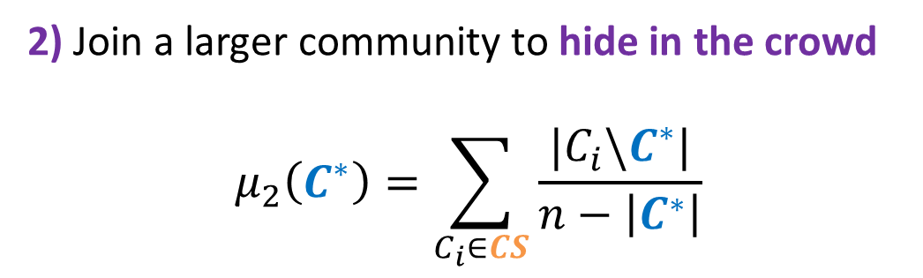
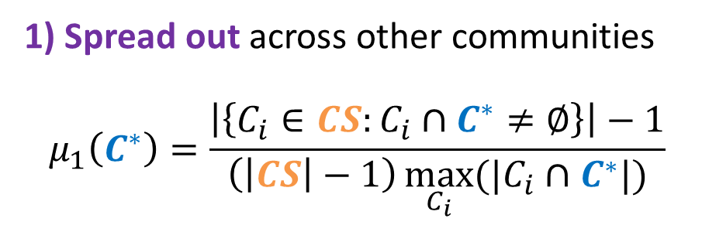
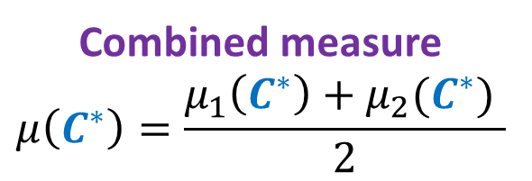

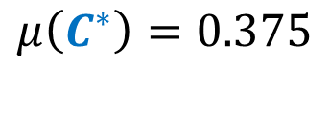
Measure of concealment
1) Spread out across other communities
$$μ_{1}\left(C^{∗}\right)=\frac{\left|\left\{C_{i}∈CS:C_{i}∩C^{∗}≠∅\right\}\right|−1}{\left(\left|CS\right|−1\right)\max_{C_{i}}{(|C_{i}∩C^{∗}|)}}$$
2) Join a larger community to hide in the crowd
$$μ_{2}\left(C^{∗}\right)=\sum_{C_{i}∈CS}{\frac{|C_{i}\backslash C^{∗}|}{n−\left|C^{∗}\right|}}$$
  Combined measure
  $$μ\left(C^{∗}\right)=\frac{μ_{1}\left(C^{∗}\right)+μ_{2}(C^{∗}) }{2}$$
<
<
$$μ(C^{∗})=0$$
$$μ\left(C^{∗}\right)=0.375$$
$$μ\left(C^{∗}\right)=1$$
M Waniek, T Michalak, M Wooldridge, T Rahwan. Hiding individuals and communities in a social network. Nature Human Behaviour (2018)

Slide 37
Our heuristic DICE (Disconnect Internally, Connect Externally)
Every member of the community finds one new (randomly chosen) neighbour from outside the community.
The members might also disconnect some edges inside the community.
M Waniek, T Michalak, M Wooldridge, T Rahwan. Hiding individuals and communities in a social network. Nature Human Behaviour (2018)

Slide 38
Simulation results
Facebook fragment
(786 nodes, 14,027 edges)
Madrid bombing network
(70 nodes, 96 edges)
Scale free networks
(1000 nodes, 2994 edges)
Community detection algorithm used by the seeker
M Waniek, T Michalak, M Wooldridge, T Rahwan. Hiding individuals and communities in a social network. Nature Human Behaviour (2018)

Slide 39

  Hiding from
  link prediction

Slide 40


Link prediction algorithms
Link prediction algorithms evaluate the likelihood of existence of a not-yet-discovered (or simply unknown) edge between a pair of nodes.
Similarity indices are link prediction algorithms that assign a score to any pair of nodes that are not connected in the network.
$$0.7$$
$$0.1$$

Slide 41
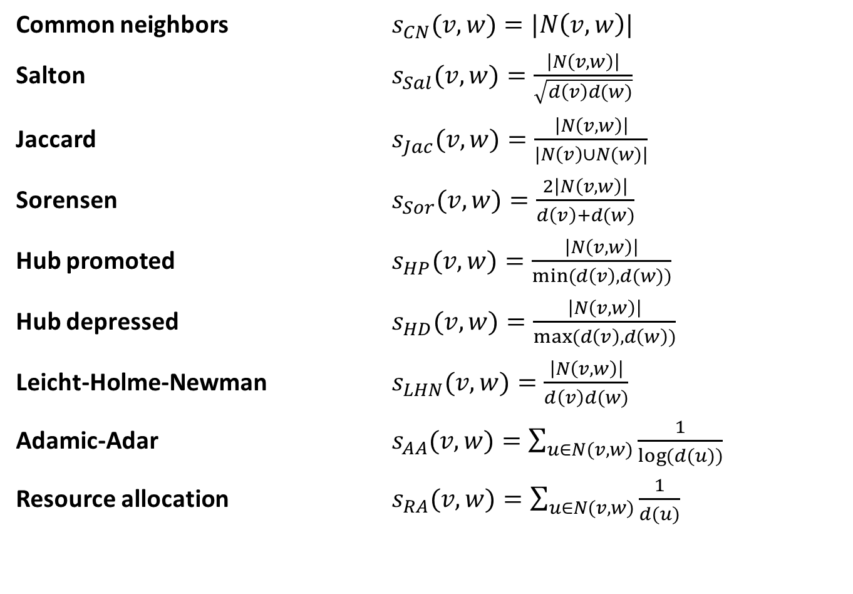
Local similarity indices
Common neighbors $s_{CN}(v,w)=|N\left(v,w\right)|$
Salton $s_{Sal}(v,w)=\frac{\left|N\left(v,w\right)\right|}{\sqrt{d\left(v\right)d(w)}}$
Jaccard $s_{Jac}(v,w)=\frac{\left|N\left(v,w\right)\right|}{|N\left(v\right)∪N(w)|}$
Sorensen $s_{Sor}(v,w)=\frac{2\left|N\left(v,w\right)\right|}{d\left(v\right)+d(w)}$
Hub promoted $s_{HP}(v,w)=\frac{\left|N\left(v,w\right)\right|}{min⁡(d\left(v\right),d(w))}$
Hub depressed $s_{HD}(v,w)=\frac{\left|N\left(v,w\right)\right|}{max⁡(d\left(v\right),d\left(w\right))}$
Leicht-Holme-Newman $s_{LHN}(v,w)=\frac{\left|N\left(v,w\right)\right|}{d\left(v\right)d(w)}$
Adamic-Adar $s_{AA}(v,w)=\sum_{u∈N(v,w)}{\frac{1}{\log{(d(u))}}}$
Resource allocation $s_{RA}(v,w)=\sum_{u∈N(v,w)}{\frac{1}{d(u)}}$
All considered indices are based in some way on the set of common neighbors

Slide 42


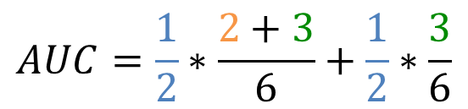

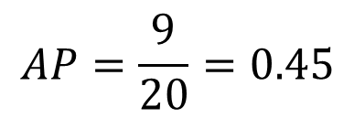



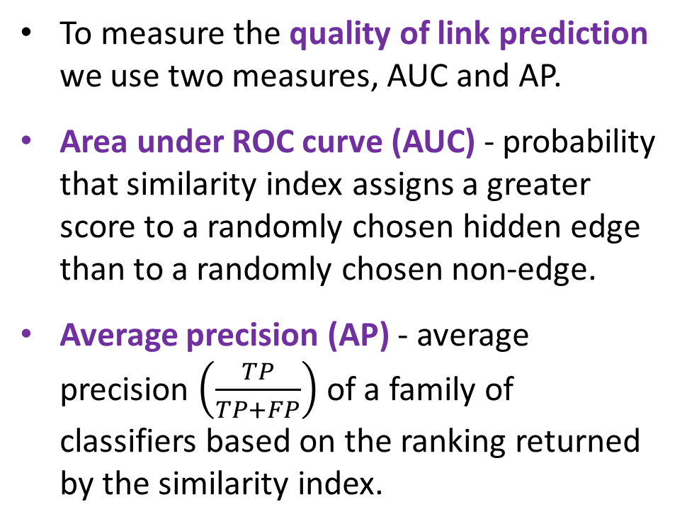

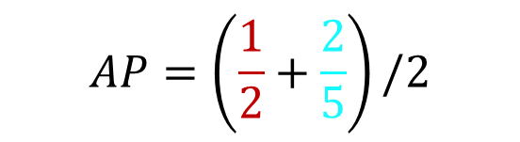





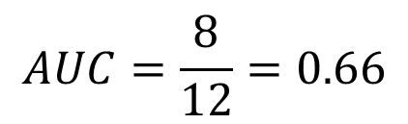



Measuring the quality of link prediction
To measure the quality of link prediction we use two measures, AUC and AP.
Area under ROC curve (AUC) - probability that similarity index assigns a greater score to a randomly chosen hidden edge than to a randomly chosen non-edge.
Average precision (AP) - average precision $\left(\frac{TP}{TP+FP}\right)$ of a family of classifiers based on the ranking returned by the similarity index.
$$0.95$$
Actual non-edge
$$>$$
$$0.87$$
Hidden edge
$$>$$
$$0.95$$
Score assigned by
link prediction
$$0.76$$
$$>$$
$$0.49$$
$$AUC=\frac{1}{2}∗\frac{2+3}{6}+\frac{1}{2}∗\frac{3}{6}$$
$$>$$
$$0.41$$
$$>$$
$$AUC=\frac{8}{12}=0.66$$
$$0.32$$
$$>$$
$$0.26$$
$$AP=\left(\frac{1}{2}+\frac{2}{5}\right)/2$$
$$>$$
$$0.11$$
$$AP=\frac{9}{20}=0.45$$

Slide 43
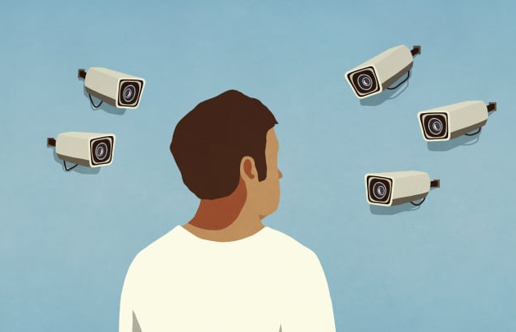
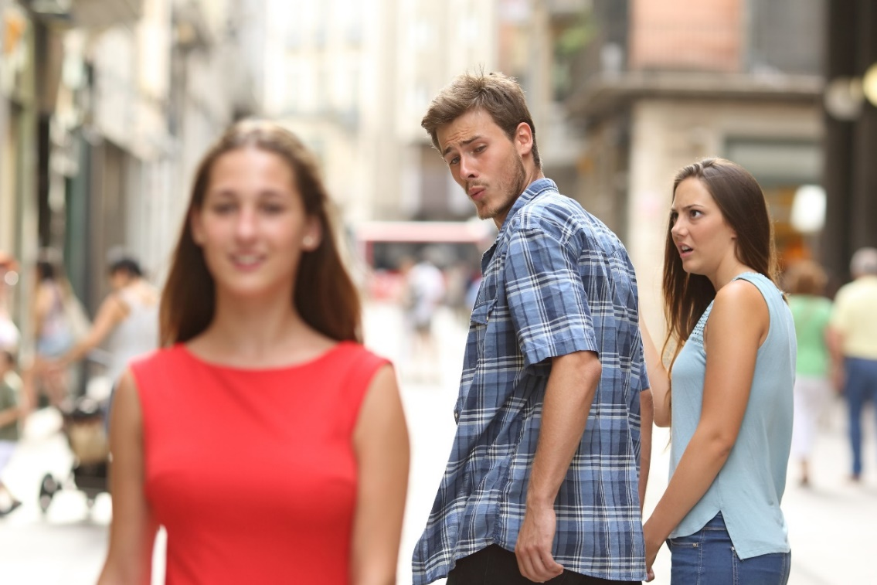
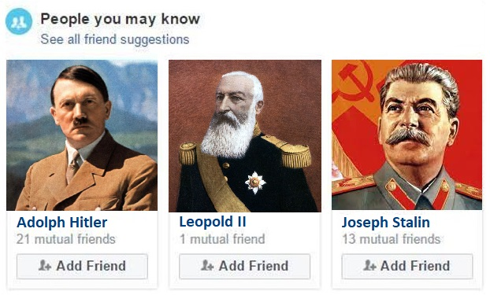
Hiding from link prediction
The unwarranted use of link prediction algorithms raises a lot of privacy-related issues.
We might prefer to keep some of our relationships private.
Link prediction may arrive at erroneous conclusions, associating us with people we do not know.
M Waniek, K Zhou, Y Vorobeychik, E Moro, T Michalak, T Rahwan. How to hide one’s relationships from link prediction algorithms. Scientific Reports (2019)

Slide 44




Hiding from link prediction
$$0.85$$
$$0.15$$
Choose how to spend the budget, i.e., which edge(s) to add and which to remove
$$0.9$$
$$0.1$$
Area under ROC curve (AUC) = 0.8
Average precision (AP) = 0.7
Area under ROC curve (AUC) = 0.3
Average precision (AP) = 0.25
Edge that can be added
Edge that can be removed
M Waniek, K Zhou, Y Vorobeychik, E Moro, T Michalak, T Rahwan. How to hide one’s relationships from link prediction algorithms. Scientific Reports (2019)

Slide 45
Complexity of finding an optimal solution
Link prediction algorithm | Hiding complexity
Common neighbors
Salton
Jaccard
Sorensen
Hub promoted
Hub depressed
Leicht-Holme-Newman
Adamic-Adar
Resource allocation
Link prediction algorithm | Hiding complexity
Common neighbors | NP-complete
Salton | NP-complete
Jaccard | NP-complete
Sorensen | NP-complete
Hub promoted | NP-complete
Hub depressed | NP-complete
Leicht-Holme-Newman | NP-complete
Adamic-Adar | NP-complete
Resource allocation | NP-complete
M Waniek, K Zhou, Y Vorobeychik, E Moro, T Michalak, T Rahwan. How to hide one’s relationships from link prediction algorithms. Scientific Reports (2019)

Slide 46
Our heuristics
Closed Triad Removal (CTR)
Decreasing scores of hidden edges by removing edges
Open Triad Creation (OTC)
Increasing scores of other
non-edges by adding edges
by removing
this
by adding this
these become more exposed
these become more hidden
this becomes more hidden
M Waniek, K Zhou, Y Vorobeychik, E Moro, T Michalak, T Rahwan. How to hide one’s relationships from link prediction algorithms. Scientific Reports (2019)

Slide 47
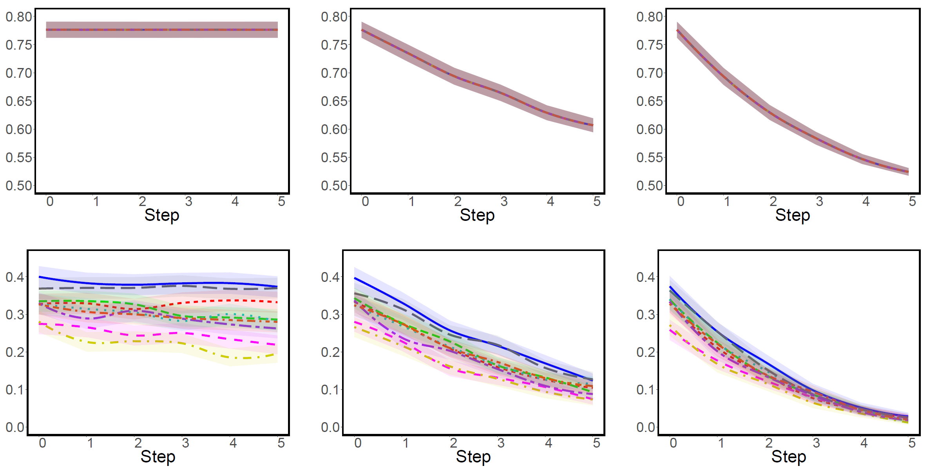
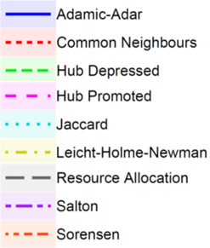
Hiding in massive real-life network
Here, we consider hiding in a telecommunication network of one of the major European cellular providers, consisting of 248,763 nodes and 829,725 edges.
OTC
OTC & CTR
CTR
AUC
AP
M Waniek, K Zhou, Y Vorobeychik, E Moro, T Michalak, T Rahwan. How to hide one’s relationships from link prediction algorithms. Scientific Reports (2019)

Slide 48
The effects of size and density
Is it easier to hide your connections in small or large networks?
Is it easier to hide your connections in sparse or dense networks?
We perform simulations on randomly-generated networks of varying size and density and compare relative value of AUC and AP after hiding.
?
?
M Waniek, K Zhou, Y Vorobeychik, E Moro, T Michalak, T Rahwan. How to hide one’s relationships from link prediction algorithms. Scientific Reports (2019)

Slide 49

The effects of size and density
It is ea
M Waniek, K Zhou, Y Vorobeychik, E Moro, T Michalak, T Rahwan. How to hide one’s relationships from link prediction algorithms. Scientific Reports (2019)

Slide 50


Random vs strategic changes
Is the hiding effectiveness actually affected by the strategic choice of edges to add/remove, or rather is it just a result of performing any changes in the network?
We perform simulations comparing the effects of our heuristics with the effects of random changes (given the same sets of edges allowed to be added/removed).
?
M Waniek, K Zhou, Y Vorobeychik, E Moro, T Michalak, T Rahwan. How to hide one’s relationships from link prediction algorithms. Scientific Reports (2019)

Slide 51




Random vs strategic hiding
Relative change in AUC
Relative change in AP
Adding edges
Removing edges
Adding edges
Removing edges
More exposed
More exposed
More exposed
More exposed
Similarity index
used by the seeker
Similarity index
used by the seeker
Similarity index
used by the seeker
Similarity index
used by the seeker
M Waniek, K Zhou, Y Vorobeychik, E Moro, T Michalak, T Rahwan. How to hide one’s relationships from link prediction algorithms. Scientific Reports (2019)

Slide 52

  Hiding from
  source detection

Slide 53

Social diffusion
We consider a process spreading in a social network, e.g., an infectious disease or a piece of information.
The process begins with only one node, the source, being active.
The process then spreads in the network over $T$ rounds according to some rules.
In this presentation we will focus on results for the Susceptible-Infected model, where during each round every active nodes activates susceptible neighbors with a given probability.

Slide 54
Source detection
Source detection is the task of inferring which node was the source based on the state of the network after the diffusion took place.
Information available is the structure of the network and the state of each node, i.e., whether it is active or not.
We will focus on methods that produce a ranking of all nodes, with the leader of the ranking being the best candidate for the source.

Slide 55
Source detection algorithms
Random walk – approximate the diffusion with random walks
Monte Carlo – repeatedly start diffusion from each node and see how similar the outcomes are to the observed state
Degree
Closeness
Betweenness
Eigenvector
Rumor
Compute centrality in the network induced by the infected nodes

Slide 56

Two ways of hiding
1)
3)
4)
6)
7)
11)
D
H
A
B
C
E
I
Closeness
1)
2)
4)
6)
7)
9)
D
E
F
A
Hiding by
adding nodes
D
F
G
B
B
C
H
J
D
E
E
Closeness
H
I
I
J
K
F
G
F
C
B
L
K
H
I
J
Hiding by adding or removing edges
1)
3)
5)
7)
9)
A
E
J
K
C
I
K
B
C
D
L
D
E
H
Closeness
Given a budget $b$, which edges to add/remove so that there are at least $ω$ nodes above the evader in the ranking of algorithm $σ$?
F
G
F
H
I
C
J
K
K
B
L
J
M Waniek, P Holme, M Cebrian, T Rahwan. Social diffusion sources can escape detection. iScience (2022)

Slide 57
Computational complexity
Source detection algorithm | Adding nodes | Modifying edges
Degree | P | NP-complete
Closeness | NP-complete | NP-complete
Betweenness | NP-complete | NP-complete
Rumor | NP-complete | NP-complete
Random walk | NP-complete | NP-complete
Monte Carlo | NP-complete | NP-complete
Source detection algorithm | Adding nodes | Modifying edges
Degree
Closeness
Betweenness
Rumor
Random walk
Monte Carlo
M Waniek, P Holme, M Cebrian, T Rahwan. Social diffusion sources can escape detection. iScience (2022)

Slide 58
Hiding heuristics – adding nodes
 | Hub | Degree | Random
Supporters only
Clique
M Waniek, P Holme, M Cebrian, T Rahwan. Social diffusion sources can escape detection. iScience (2022)

Slide 59
Hiding heuristics – modifying edges
 | Max degree | Min degree | Random
Adding edges
Removing edges
M Waniek, P Holme, M Cebrian, T Rahwan. Social diffusion sources can escape detection. iScience (2022)

Slide 60


Efficiency of hiding from Eigenvector
Before hiding
Adding nodes
In Barabasi-Albert (BA) networks the source is hidden by the very structure of the network, particularly in large and dense networks.
However, in Erdos-Renyi (ER) and Watts-Strogatz (WS) networks the source is exposed.
Modifying edges
The larger the highlighted triangle, the more effective the heuristic.
Degree clique is the most effective heuristic here, the hexagon’s color corresponds to its performance.
In general, the most effective heuristics are those that connect the bots into a clique.
Notes:
Conclusion from first row: sometimes you are hidden without doing anything (e.g., in BA)
Conclusion from second row: adding dense group is better than separate nodes
Conclusion from third row: removing edges is much better than adding, adding can expose you even more

Slide 61
Hiding the source of a real cascade
We also attempt to hide the sources of eight new Twitter hashtags in a retweet network consisting of 241,698 nodes and 366,539 edges.
Adding nodes
Modifying edges
M Waniek, P Holme, M Cebrian, T Rahwan. Social diffusion sources can escape detection. iScience (2022)

Slide 62

Project idea #2 Anomaly detection for hiding
Research question
Can anomaly detection algorithms be used to identify the nodes who perform strategic rewiring of the network?

Slide 63

  Hiding from
  stance detection

Slide 64

Stance detection
Stance detection algorithms allow to infer an opinion (either positive or negative) a person holds about certain topic based on this person’s publicly available social media data (in this study we focus our attention on Twitter).
Notice that the opinion does not have to expressed directly, as the algorithms can read up on subtle clues imperceivable to a human’s eye.
Positive opinion
Stance detection
or
Negative opinion

Slide 65




The problem with stance detection
M Waniek, T Rahwan, W Magdy. Hiding opinions from machine learning. PNAS Nexus (2022)

Slide 66

The datasets we use
To explore these issues, we use two datasets:
  To train stance detection algorithms, we used a dataset of tweets with opinions they indicate towards atheism, feminism, and Hillary Clinton.
  A survey study with 1,143 participants we recruited via Amazon Mechanical Turk, with questions based on state-of-the-art SVM classifier.
✓
✗
✓
✓
…
…
✗
M Waniek, T Rahwan, W Magdy. Hiding opinions from machine learning. PNAS Nexus (2022)

Slide 67

Can people hide opinions from AI without help?
We focused on three types of features: a word used in a tweet, an account followed, and an account mentioned in a tweet.
For each of the topic and each feature type, we identify the three features most strongly associated with the “against” stance, and the three most strongly associated with the “in favor” stance, according to the SVM classifier.
For each feature, we asked participants to specify the stance that it indicates towards the topic.
@baptism (Atheism follow)
@hillaryclinton (Clinton follow)
'faith' (Atheism word)
@billclinton (Clinton follow)
@NoMaaam (Feminism mention)
@shehasmyvote (Clinton follow)
@flaccid (Feminism mention)
@HillaryClinton (Clinton mention)
@KLOVEnews (Atheism mention)
@Lzats (Feminism mention)
@srisri (Atheism follow)
'freethinker' (Atheism word)
@nianticproject (Clinton follow)
@VictoriaOsteen (Atheism mention)
@richarddawkins (Atheism follow)
@NinjaEconomics (Feminism mention)
@aolswamiji (Atheism follow)
Correct answer
@Gr8Darwinians (Atheism mention)
Correct answer
'hope' (Atheism word)
'vote' (Clinton word)
@husamhsm (Feminism follow)
@kourtneykardash (Feminism mention)
@BernieSanders (Clinton mention)
@stephenfry (Atheism follow)
'feminists' (Feminism word)
@stephenfry (Atheism mention)
'needs' (Clinton word)
@stephenking (Atheism follow)
'peace' (Atheism word)
@twitterfashion (Feminism follow)
@theclairvoyant5 (Clinton mention)
'feministsemst' (Feminism word)
'Clinton' (Clinton word)
'way' (Clinton word)
@drjuan (Clinton follow)
@CDNelectricity (Clinton mention)
@x (Feminism mention)
'bet' (Clinton word)
'feminism' (Feminism word)
@nytimes (Atheism mention)
'male' (Feminism word)
@anthonywhatup (Clinton mention)
'say' (Clinton word)
'rt' (Feminism word)
@emma (Feminism follow)
'religion' (Atheism word)
@char98 (Feminism follow)
@Twitter (Atheism mention)
@Olympics (Clinton mention)
@allahislamquran (Feminism follow)
@heyalaurena (Clinton follow)
'god' (Atheism word)
'good' (Feminism word)
@imrankhanpti (Feminism follow)
0
20
40
60
80
100
0
20
40
60
80
100
Strongly in favor
In favor
Neither
Against
Strongly against
M Waniek, T Rahwan, W Magdy. Hiding opinions from machine learning. PNAS Nexus (2022)

Slide 68

Can algorithms help people hide their opinions from AI?
We now try to hide people’s opinion based on insights drawn from the SVM classifier.
We either remove the features that are most indicative of the real stance, or we add the features that are most indicative of the opposite stance.
We test these hiding methods against algorithms trained either on user’s contacts (the accounts they follow) or the user’s interactions (the accounts mentioned in their tweets).
User’s contacts
User’s interactions
F1 score
number of features added
number of features added
F1 score
number of features removed
number of features removed
number of features changed
number of features changed
M Waniek, T Rahwan, W Magdy. Hiding opinions from machine learning. PNAS Nexus (2022)

Slide 69

Project idea #3 Hiding using XAI
Research question
Can Explainable AI be used to develop more effective, personalized hiding methods?

Slide 70
Summary of proposed topics
Idea #1 Temporal network of scientists
Idea #2 Anomaly detection for hiding
Idea #3 Hiding using XAI
Marcin Waniek www.mjwaniek.com m.waniek@mimuw.edu.pl

