Slide 1
Seminarium
Ekonomia Algorytmiczna

Slide 2
Warunki zaliczenia
Każdy uczestnik musi w ciągu roku akademickiego wygłosić jedną prezentację:
  W semestrze zimowym (29 października - 7 stycznia) studenci 2. roku prezentują postępy pracy magisterskiej
  W semestrze letnim studenci 1. roku wygłaszają prezentację na temat jakiejś publikacji naukowej
  Tydzień przed prezentacją należy przesłać temat, abstract i slajdy
  Po prezentacji krótki feedback
Obecność na zajęciach:
  Do pięciu nieobecności na semestr
  Lista sprawdzana na początku zajęć
Warunek formalny zaliczenia:
  Na 1. roku: zatwierdzenie tematu pracy magisterskiej
  Na 2. roku: złożenie pracy magisterskiej

Slide 3

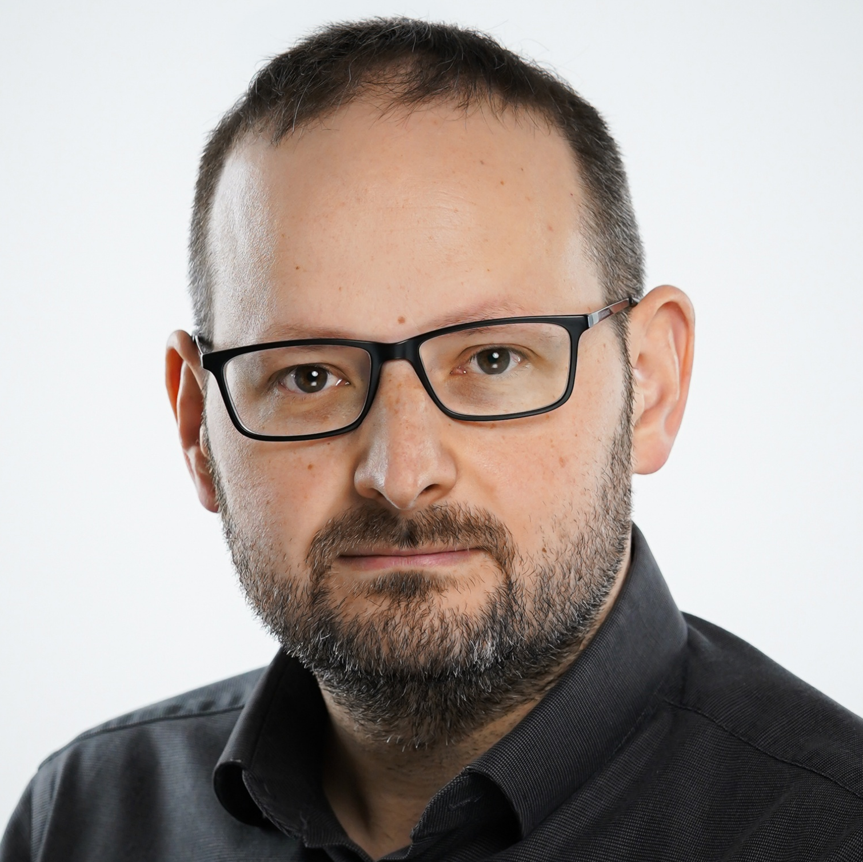
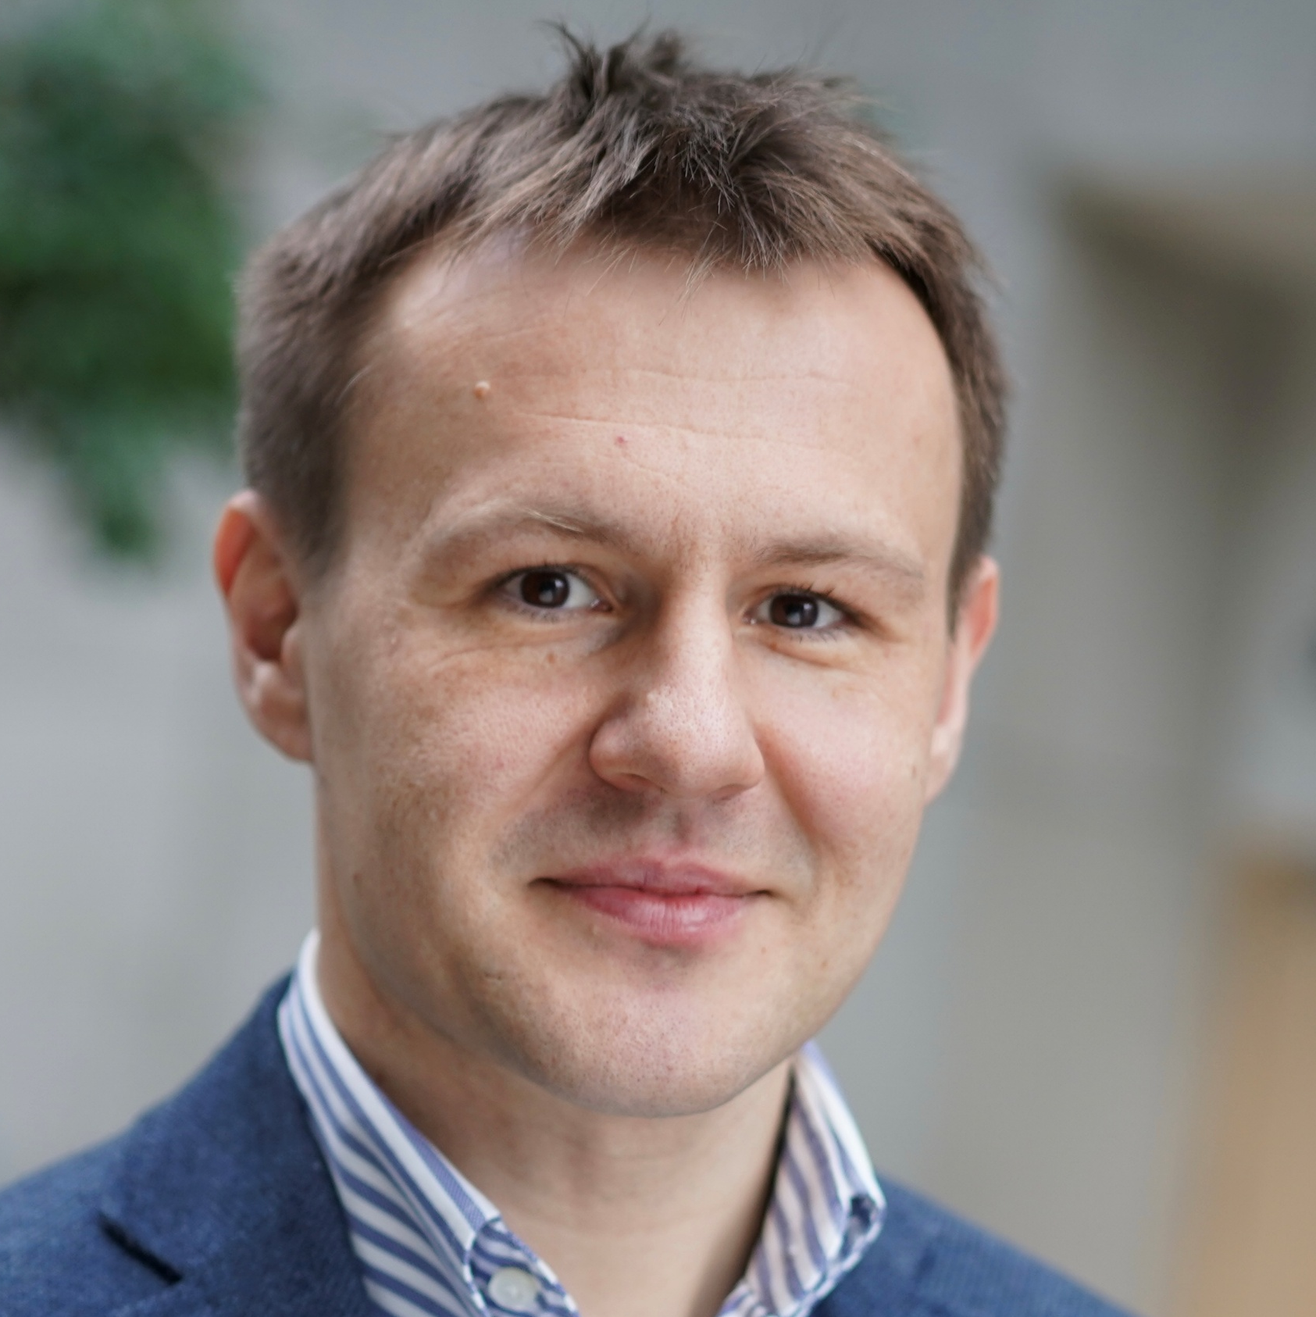


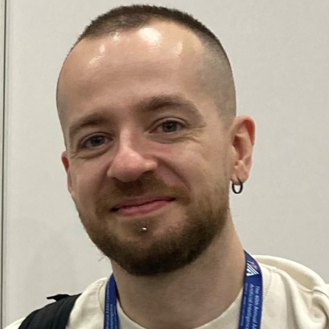
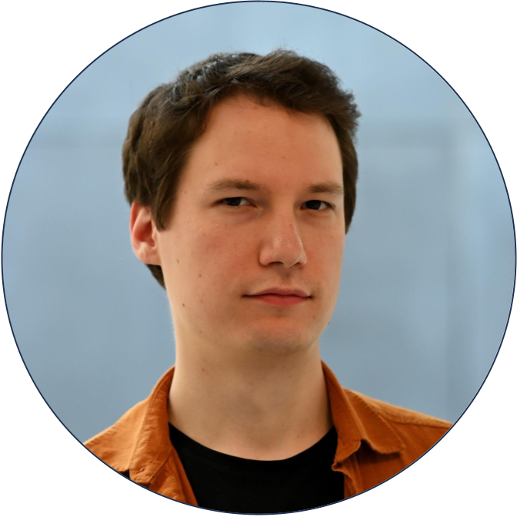
Our research group
Marcin Dziubiński
Game theory,
network economics
Oskar Skibski
Cooperative games,
network centrality
Piotr Skowron
Computational social
choice, fairness
Marcin Waniek
Strategic social
network analysis
Nidhi Rathi
Algorithmic game
theory, fairness
Artem Tsikiridis
Mechanism design,
online algorithms
Tomasz Wąs
Computational
social choice

Slide 4
Potential Master topics
Marcin Waniek

Slide 5
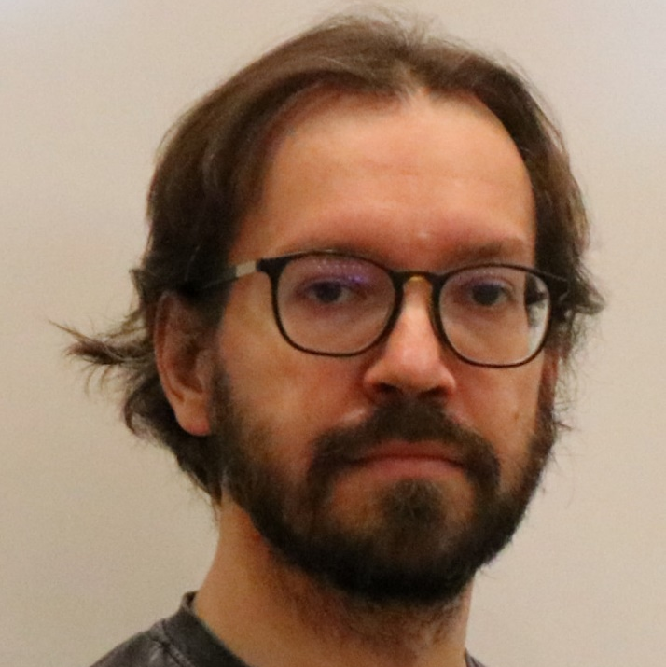
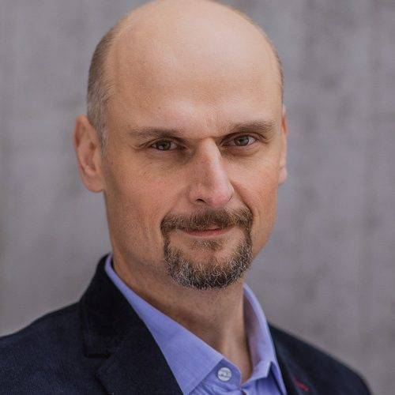


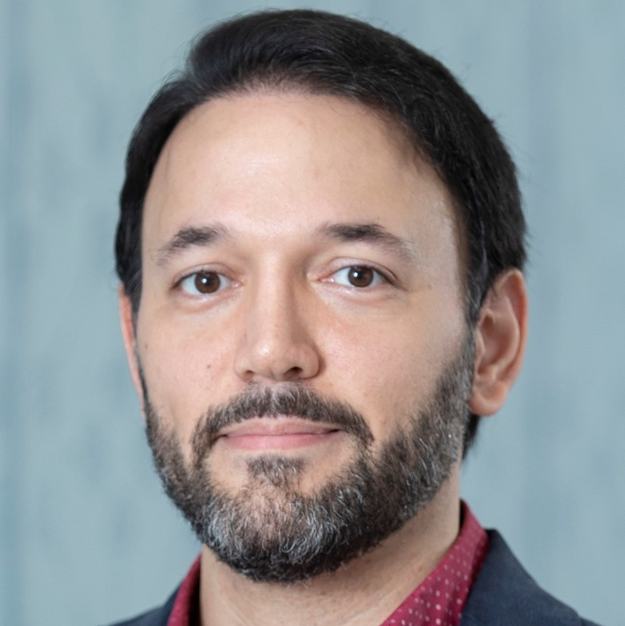

Who am I?
June 2017
Defended a PhD dissertation at MIMUW
Thesis: Hiding in Social Networks
Main supervisor: Piotr Faliszewski
Auxilliary supervisor: Tomasz Michalak
July 2017 – February 2019
Post-Doctoral Fellow
at Khalifa University
Supervisor: Aamena Alshamsi
February 2019 – September 2023
Post-Doctoral Associate
at New York University Abu Dhabi
Supervisor: Talal Rahwan

Slide 6
Centrality measures

Slide 7
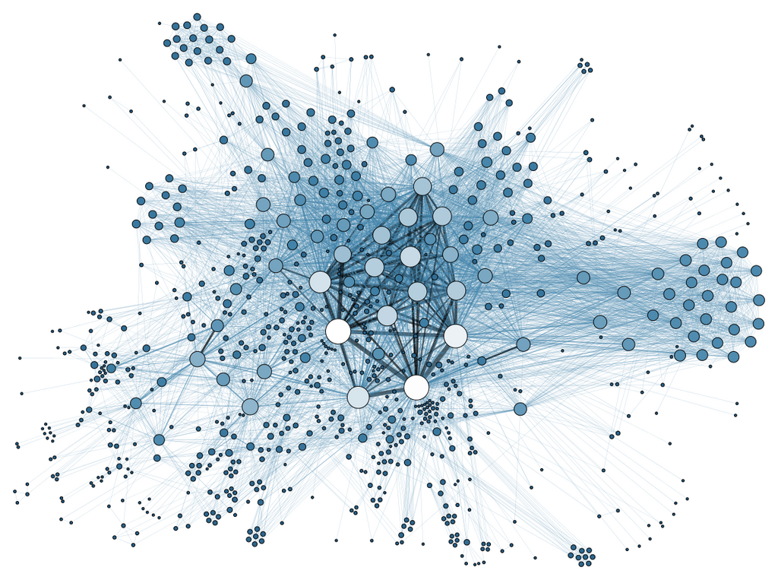
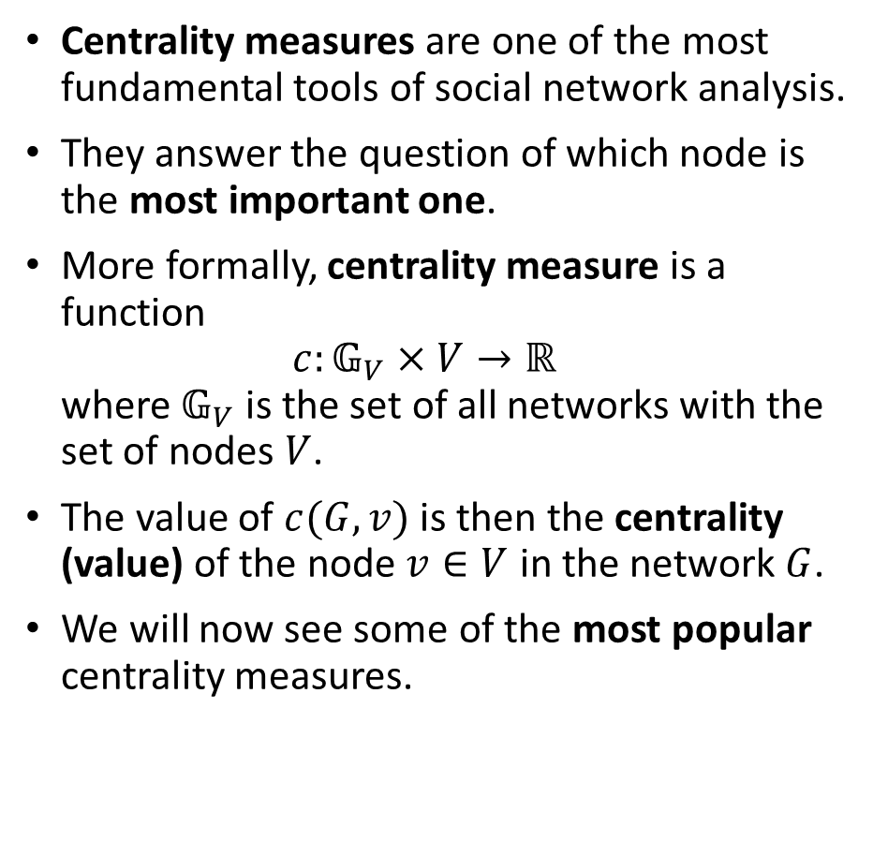
Centrality measures
Centrality measures are one of the most fundamental tools of social network analysis.
They answer the question of which node is the most important one.
More formally, centrality measure is a function
$c:𝔾_{V}×V→ℝ$
where $𝔾_{V}$ is the set of all networks with the set of nodes $V$.
The value of $c(G,v)$ is then the centrality (value) of the node $v∈V$ in the network $G$.
We will now see some of the most popular centrality measures.

Slide 8













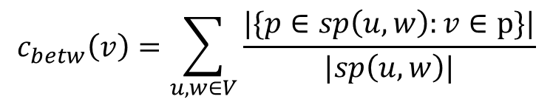








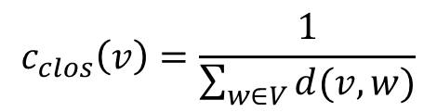









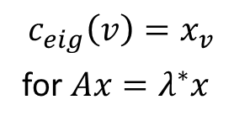



Centrality measures
Which nodes in the following network are the most important?
Degree centrality (the most important node is the one with the greatest number of friends).
Closeness centrality (the most important node is the one who is close to everyone else).
Betweeness centrality (the most important node controls the flow of information).
Eigenvector centrality (the most important node is the one with important friends).
Often, we are more interested in the centrality ranking, rather the centrality values.
$$\frac{1}{16}$$
1st
3rd
5th
6th
7th
$$\frac{1}{16}$$
$$0$$
$$0$$
$$3$$
$$3$$
$$0.42$$
$$0.42$$
A
B
A
B
C
D
$$\frac{1}{12}$$
C
D
$$\frac{1}{12}$$
$$4$$
$$4$$
$$0.5$$
$$4$$
$$4$$
$$0.5$$
$$\frac{1}{11}$$
$$12$$
$$0.34$$
E
$$3$$
E
$$\frac{1}{13}$$
$$3$$
$$10$$
F
$$0.13$$
F
G
H
G
H
$$0$$
$$0$$
$$0.06$$
$$0.06$$
$$\frac{1}{18}$$
$$\frac{1}{18}$$
$$2$$
$$2$$
$$c_{clos}\left(v\right)=\frac{1}{\sum_{w∈V}{d(v,w)}}$$
$$c_{betw}\left(v\right)=\sum_{u,w∈V}{\frac{|\{p∈sp\left(u,w\right):v∈p\}|}{|sp\left(u,w\right)|}}$$
$$c_{eig}\left(v\right)=x_{v}$$
for $Ax=λ^{∗}x$
$$c_{degr}\left(v\right)=|N\left(v\right)|$$

Slide 9

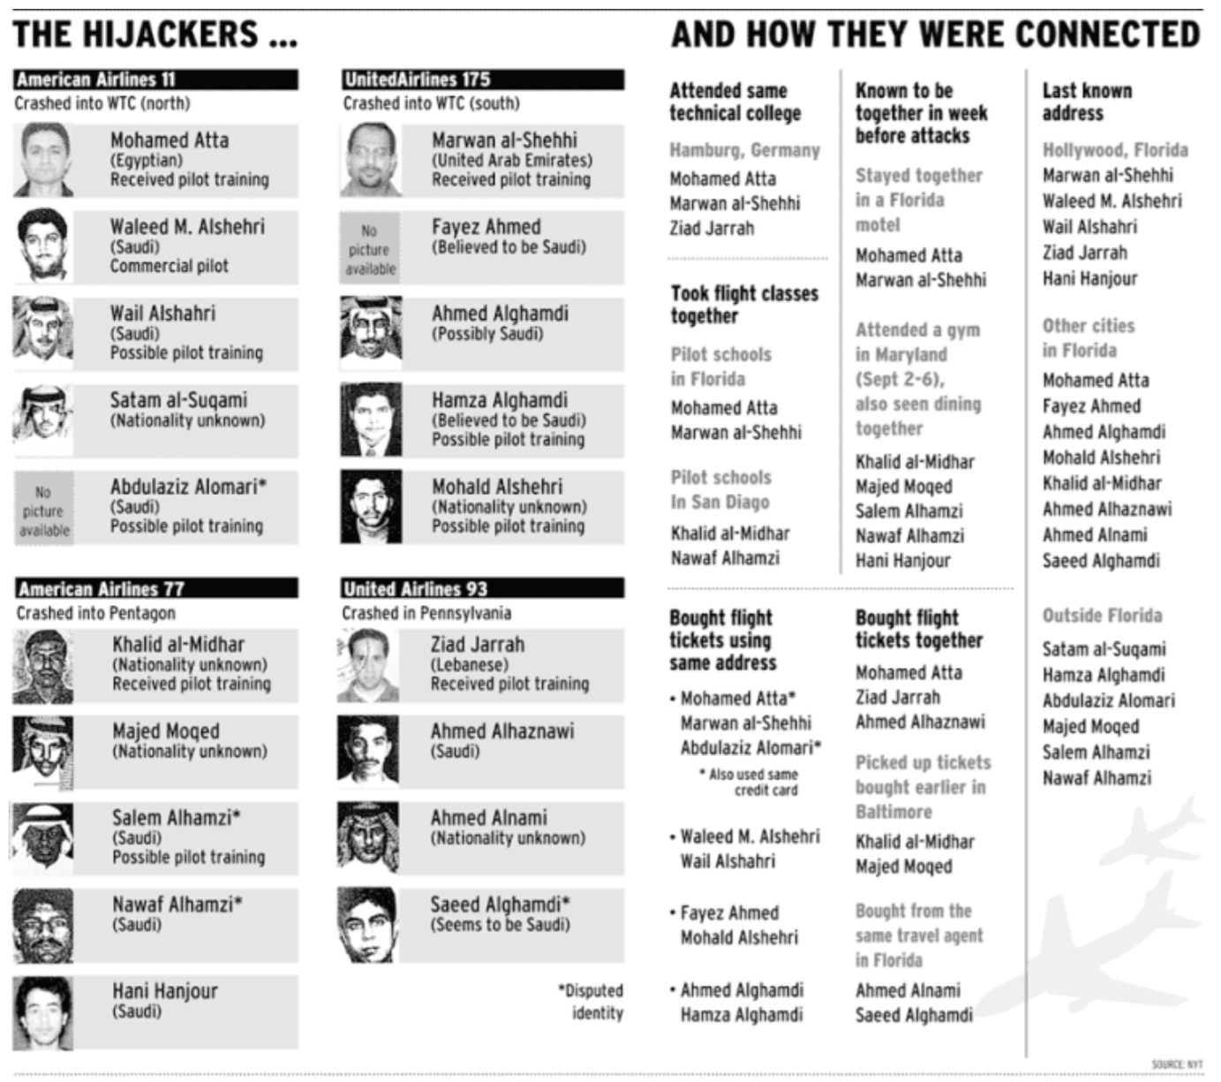
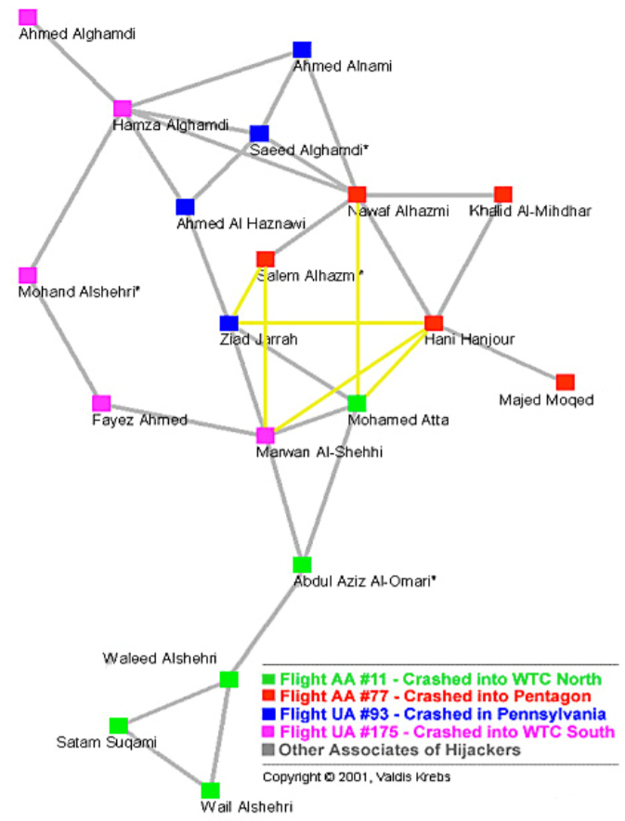
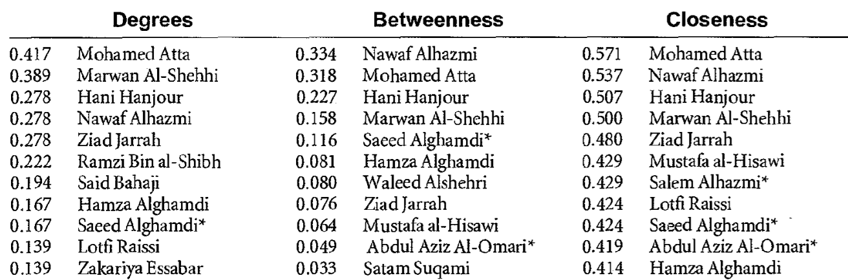
Centrality in terrorist networks
One of the applications of centrality measures is the analysis of criminal and terrorist organizations.
Krebs analyzed the structure of the 9/11 attackers’ network, constructed based on publicly available data in 2002.
Mohamed Atta is identified as the top node by two out of three most basic centrality measures (in a later, more complete network he is also the top node according to betweenness).
Later investigation confirmed that Atta was indeed the ringleader of the conspiracy.
V. E Krebs. Mapping networks of terrorist cells. Connections (2002)

Slide 10
Hiding from centrality measures

Slide 11


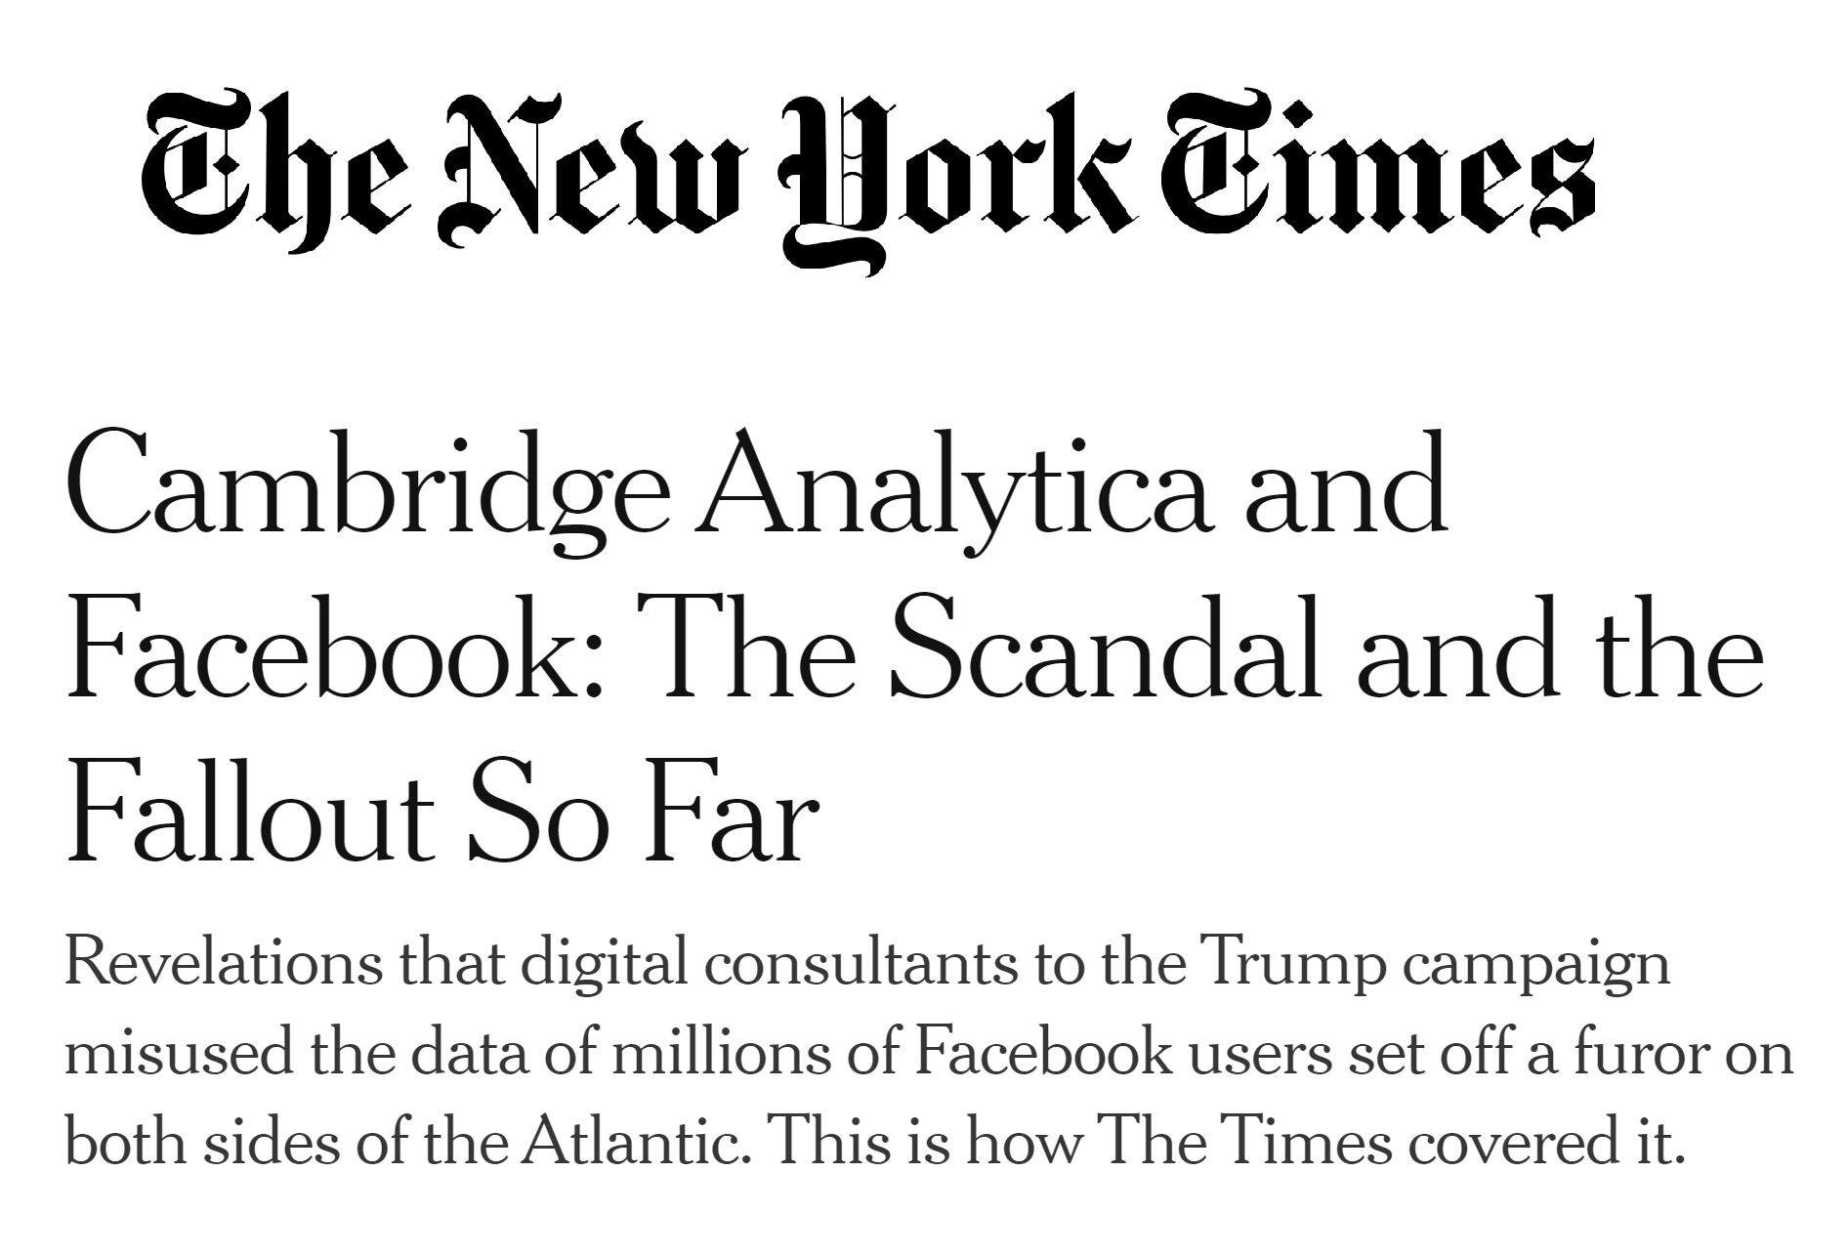
Hiding from centrality measures
Increased reliance on Internet makes it impossible to live without leaving digital traces, allowing algorithms to scrutinize our activities at an unprecedented scale.
This can be done at a massive scale, both by the corporations and the governments, leading many to fear the rise of an Orwellian society.
The literature on privacy preservation assumes the responsibility lies with a central authority, despite the repeated failures of such an approach.

Slide 12

The setting
Consider a social network, represented by a directed or undirected graph, where members of the network care about their privacy.
In particular, we assume the perspective of a specific member of this network, called the evader.
The structure of the network is being analyzed by an outside party called the seeker.
The seeker might have questions about the activities of the network, and seek answers to them using social network analysis tools.
How important is the evader?
Does the evader have any undisclosed relationships?
What is the evader’s political orientation?
The evader
The seeker

Slide 13


The main idea of this line of work
The evader
The seeker
The evader
The seeker

Slide 14

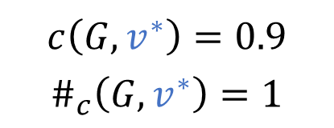
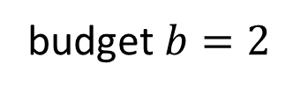
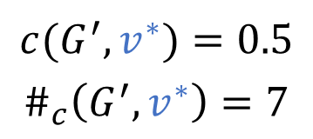
Hiding from centrality measures
Choose how to spend the budget, i.e., which edge(s) to add and which to remove
$$v^{∗}$$
$$v^{∗}$$
$$c\left(G,v^{∗}\right)=0.9$$
$$\#_{c}\left(G,v^{∗}\right)=1$$
$$c(G^{′},v^{∗})=0.5$$
$$\#_{c}\left(G^{′}, v^{∗}\right)=7$$
budget $b=2$
Edge that can be added
Edge that can be removed
M. Waniek, T. P. Michalak, M. J. Wooldridge, T. Rahwan. Hiding individuals and communities in a social network. Nature Human Behaviour (2018)

Slide 15
Complexity of finding an optimal solution
Centrality | Value | Ranking
Degree
Closeness
Betweenness
Centrality | Value | Ranking
Degree | P | NP-complete
Closeness | NP-complete | NP-complete
Betweenness | NP-complete | NP-complete
M Waniek, T Michalak, M Wooldridge, T Rahwan. Hiding individuals and communities in a social network. Nature Human Behaviour (2018)
M Waniek, T Michalak, M Wooldridge, T Rahwan. How members of covert networks conceal the identities of their leaders. ACM TIST (2021)

Slide 16



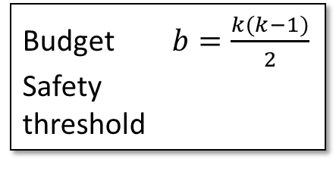







NP-hardness of decreasing degree ranking
$$v^{∗}$$
$$v_{2}$$
$$v_{2}$$
$$v_{1}$$
$$v_{3}$$
$$v_{1}$$
$$v_{3}$$
$$v_{4}$$
$$v_{4}$$
Budget $b=\frac{k(k−1)}{2}$
Safety
threshold
$$ω=k$$
Finding k-clique problem
Decreasing degree centrality ranking problem
M Waniek, T Michalak, M Wooldridge, T Rahwan. How members of covert networks conceal the identities of their leaders. ACM TIST (2021)

Slide 17
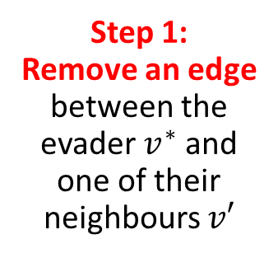
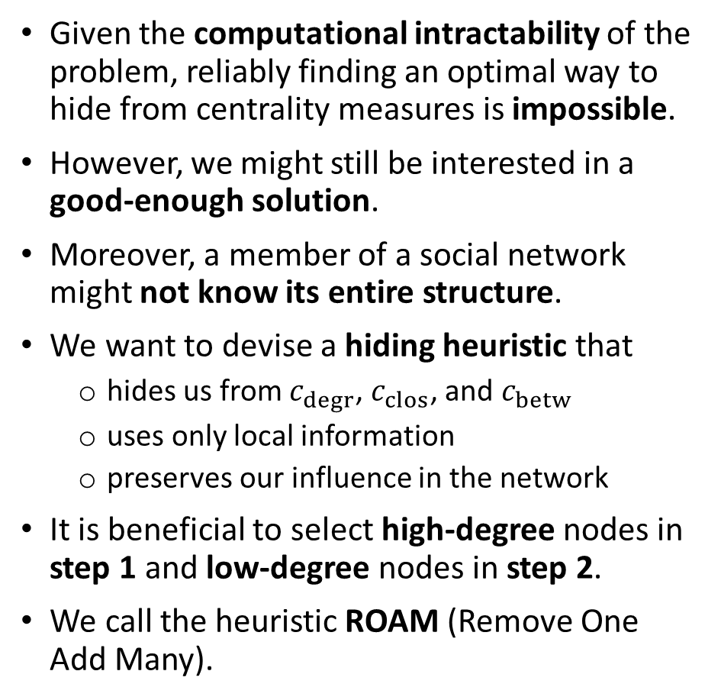

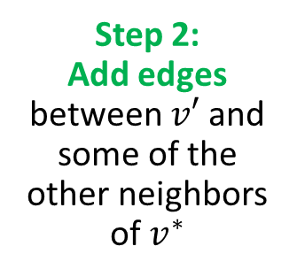
Heuristic solution
Given the computational intractability of the problem, reliably finding an optimal way to hide from centrality measures is impossible.
However, we might still be interested in a good-enough solution.
Moreover, a member of a social network might not know its entire structure.
We want to devise a hiding heuristic that
  hides us from $c_{degr}$, $c_{clos}$, and $c_{betw}$
  uses only local information
  preserves our influence in the network
It is beneficial to select high-degree nodes in step 1 and low-degree nodes in step 2.
We call the heuristic ROAM (Remove One Add Many).
Step 1:
Remove an edge
between the evader $v^{∗}$ and one of their neighbours $v′$
$$v^{∗}$$
Step 2:
Add edges
between $v′$ and some of the other neighbors of $v^{∗}$
M. Waniek, T. P. Michalak, M. J. Wooldridge, T. Rahwan. Hiding individuals and communities in a social network. Nature Human Behaviour (2018)

Slide 18
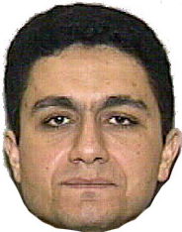

Hiding in WTC 9/11 terrorist network
26
33
36
32
Original network
1st in Degree centrality ranking
1st in Closeness centrality ranking
1st in Betweenness centrality ranking
34
21
30
35
9
10
11
25
7
After one execution of ROAM
3rd in Degree centrality ranking
2nd in Closeness centrality ranking
5th in Betweenness centrality ranking
8
29
24
Mohamed
Atta
22
12
16
27
28
23
After two executions of ROAM
5th in Degree centrality ranking
4th in Closeness centrality ranking
11th in Betweenness centrality ranking
2
1
15
13
18
4
5
14
31
3
19
20
17
M. Waniek, T. P. Michalak, M. J. Wooldridge, T. Rahwan. Hiding individuals and communities in a social network. Nature Human Behaviour (2018)

Slide 19


Building a network from scratch
What if we do not want to reshape an existing network, but rather construct a new one from scratch?
Assume we have a group of network leaders…
… and a group of followers.
We want to connect them into a network so that:
  there are no leaders in top centrality ranking positions,
  the leaders can effectively communicate with the rest of the network.
M. Waniek, T. P. Michalak, M. J. Wooldridge, T. Rahwan. How members of covert networks conceal the identities of their leaders. ACM TIST (2021)

Slide 20
















The captain network
The captain network is constructed in the following way:
  We start with a group of leaders connected into a clique.
  To each leader we assign a group of captains.
  We connect the captains into a full k-partite graph.
  Each of the remaining followers gets connected with one captain from each group.
In this network every captain is guaranteed to have greater degree, closeness and betweenness centrality than any of the leaders (the figure depicts the difference in centrality between a leader and a captain).
$$l_{1}$$
$$l_{3}$$
$$l_{2}$$
$$c_{1,1}$$
$$c_{2,1}$$
$$c_{3,1}$$
$$…$$
$$…$$
$$…$$
$$c_{1,k}$$
$$c_{2,k}$$
$$c_{3,k}$$
$$…$$
$$x_{1}$$
$$x_{2}$$
$$x_{m}$$
M. Waniek, T. P. Michalak, M. J. Wooldridge, T. Rahwan. How members of covert networks conceal the identities of their leaders. ACM TIST (2021)

Slide 21
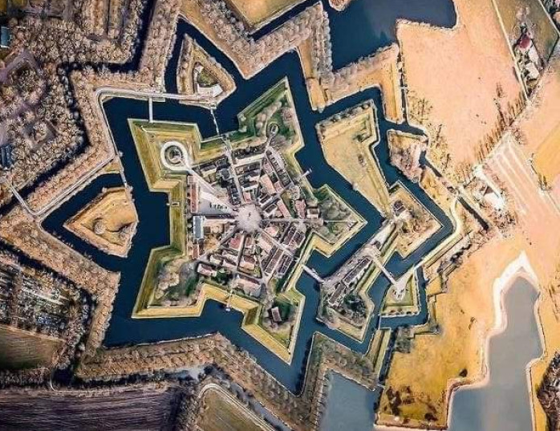
Project idea #1 Resistant centrality measures
Research question
Can we design centrality measures that are inherently resistant to hiding attempts?

Slide 22
Temporal networks

Slide 23







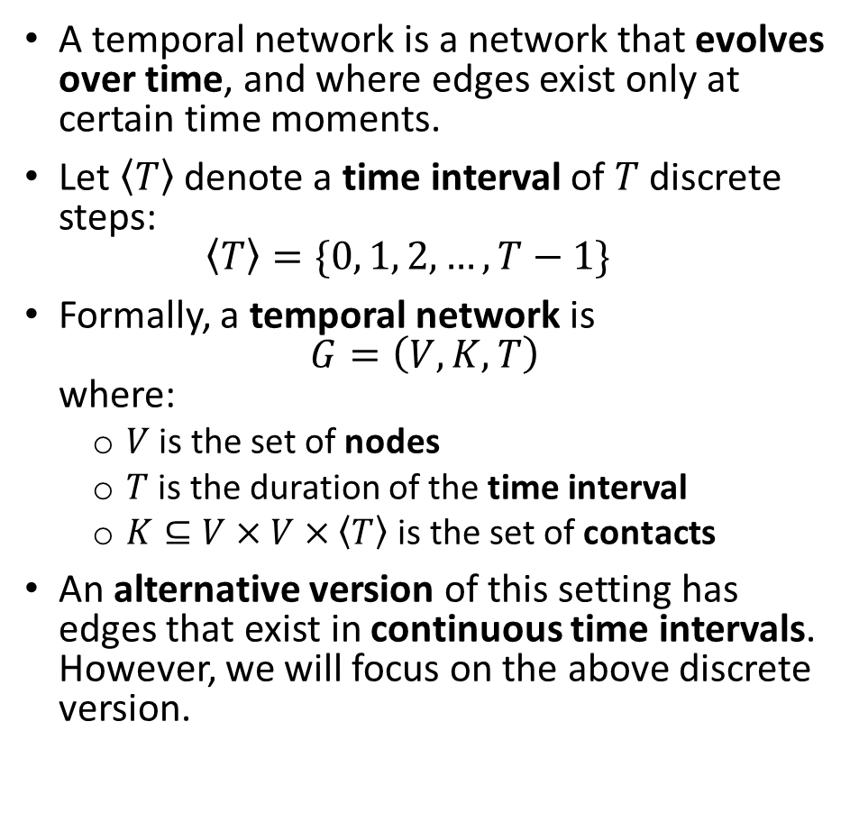











Temporal networks
A temporal network is a network that evolves over time, and where edges exist only at certain time moments.
Let $\left\langle T\right\rangle$ denote a time interval of $T$ discrete steps:
$\left\langle T\right\rangle =\{0, 1, 2,…,T−1\}$
Formally, a temporal network is
$G=\left(V,K,T\right)$
where:
  $V$ is the set of nodes
  $T$ is the duration of the time interval
  $K⊆V×V×\left\langle T\right\rangle$ is the set of contacts
An alternative version of this setting has edges that exist in continuous time intervals. However, we will focus on the above discrete version.
B
$$10$$
D
$$5, 17$$
F
$$23$$
H
$$1, 13$$
$$27$$
$$5, 20$$
$$25$$
$$21$$
A
$$0, 20$$
I
$$12$$
$$1$$
$$23$$
$$3, 9$$
$$5, 6$$
C
$$14$$
E
$$3, 20$$
G
$$27$$
J
$$T=28$$

Slide 24






















Different ways of presenting a network
There are several distinct ways in which temporal networks can be presented.
First, that we have already seen, is to just draw a simple graph, and add labels on the edges with the moments of time in which they exist.
Second, is to draw it in the form of a multilayer network, with one layer for each time moment.
Finally, one particularly interesting form is to draw a timeline with each node as a horizontal line, and contacts as arcs connecting these lines.
Dave
$$1,6$$
$$0,4,6$$
$$6$$
Alice
Bob
$$1,2,3$$
$$0,5$$
Carol
$$0$$
$$1$$
$$2$$
$$3$$
$$4$$
$$5$$
$$6$$
$$7$$
$$t$$
$$t=0$$
$$t=1$$
$$t=2$$
$$t=3$$
$$t=4$$
$$t=5$$
$$t=6$$

Slide 25

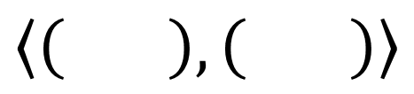
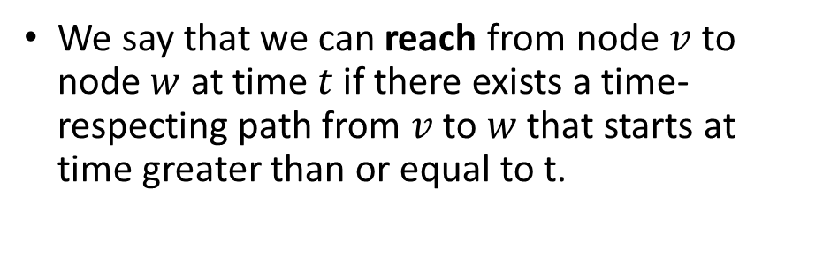
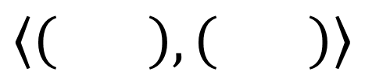

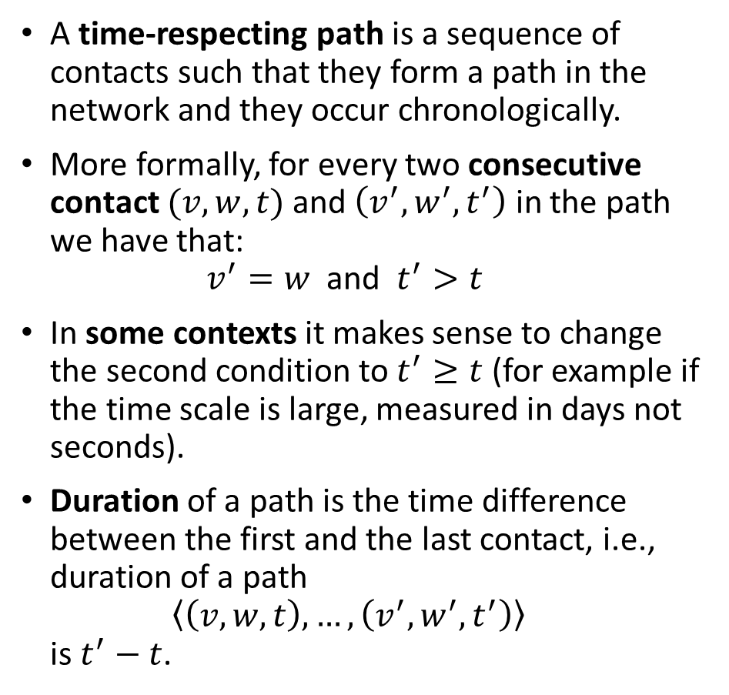


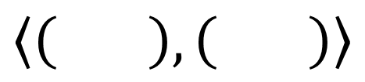


Time-respecting paths
A time-respecting path is a sequence of contacts such that they form a path in the network and they occur chronologically.
More formally, for every two consecutive contact $(v,w,t)$ and $\left(v^{′},w^{′},t^{′}\right)$ in the path we have that:
$v^{′}=w \text{and } t^{′}>t$
In some contexts it makes sense to change the second condition to $t^{′}≥t$ (for example if the time scale is large, measured in days not seconds).
Duration of a path is the time difference between the first and the last contact, i.e., duration of a path
$\left\langle \left(v,w,t\right)\text{,}…,\left(v^{′},w^{′},t^{′}\right)\right\rangle$
is $t^{′}−t$.
$$\left\langle \left( \right),\left( \right)\right\rangle$$
Dave
time-respecting path
$$1$$
$$4$$
$$1,6$$
$$0,4,6$$
not time-respecting path
$$6$$
$$\left\langle \left( \right),\left( \right)\right\rangle$$
Alice
Bob
$$4$$
$$1$$
$$1,2,3$$
$$0,5$$
maybe time-respecting path
$$\left\langle \left( \right),\left( \right)\right\rangle$$
Carol
$$6$$
$$6$$
We say that we can reach from node $v$ to node $w$ at time $t$ if there exists a time-respecting path from $v$ to $w$ that starts at time greater than or equal to t.

Slide 26






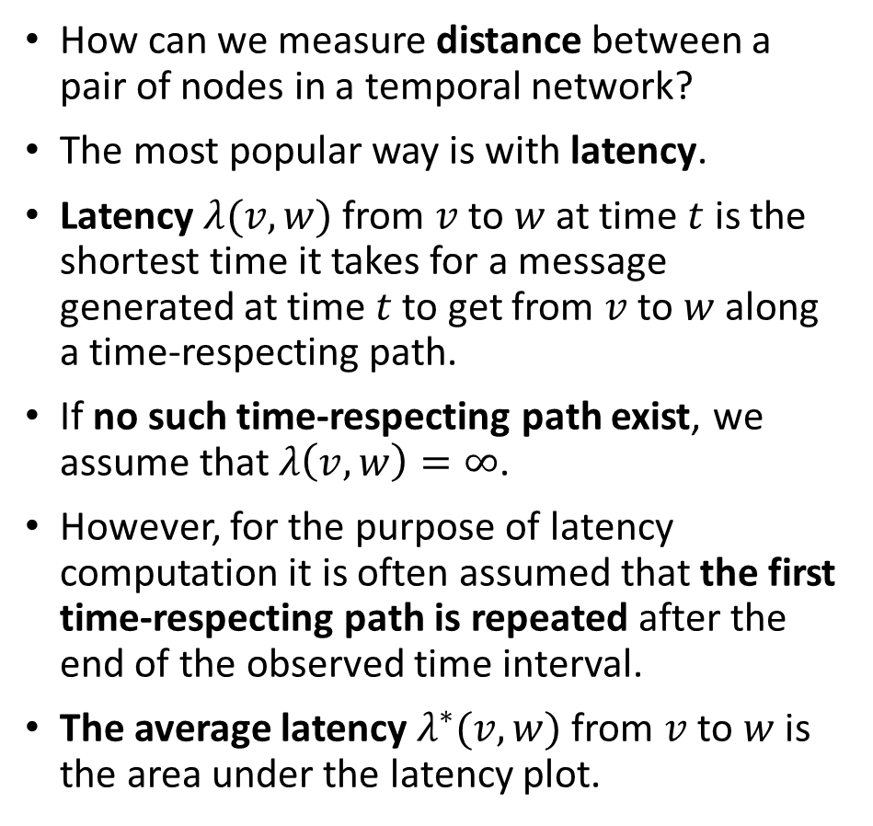
















Latency as the measure of distance
How can we measure distance between a pair of nodes in a temporal network?
The most popular way is with latency.
Latency $λ(v,w)$ from $v$ to $w$ at time $t$ is the shortest time it takes for a message generated at time $t$ to get from $v$ to $w$ along a time-respecting path.
If no such time-respecting path exist, we assume that $λ\left(v,w\right)=∞$.
However, for the purpose of latency computation it is often assumed that the first time-respecting path is repeated after the end of the observed time interval.
The average latency $λ^{∗}(v,w)$ from $v$ to $w$ is the area under the latency plot.
Dave
$$1,6$$
$$0,4,6$$
Alice
$$6$$
Bob
$$1,2,3$$
$$0,5$$
Carol
$$5$$
$$4$$
$$λ(Alice,Bob)$$
$$3$$
$$2$$
$$1$$
$$λ^{∗}(Alice,Bob)$$
$$0$$
$$0$$
$$1$$
$$2$$
$$3$$
$$4$$
$$5$$
$$6$$
$$7$$
$$t$$

Slide 27

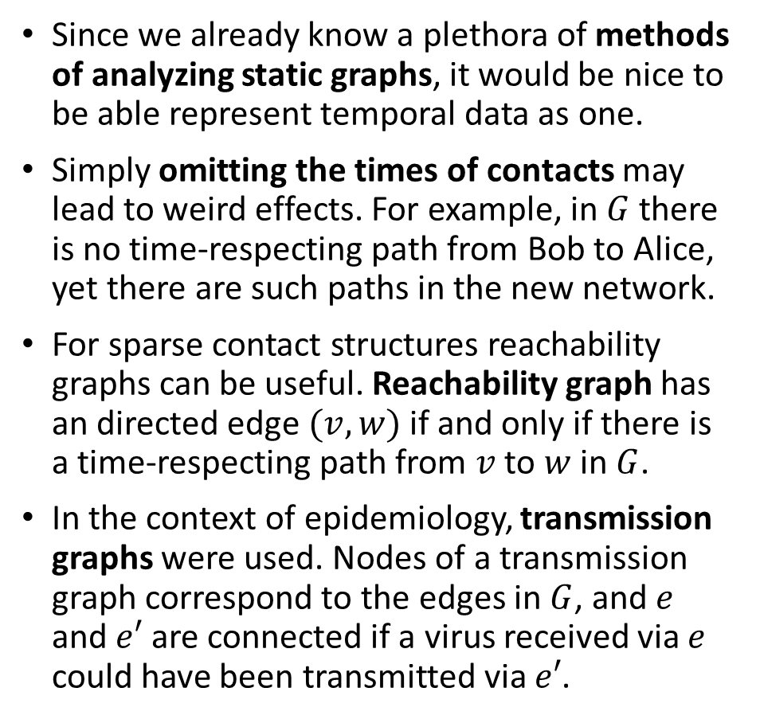



Temporal data as a static graph
Since we already know a plethora of methods of analyzing static graphs, it would be nice to be able represent temporal data as one.
Simply omitting the times of contacts may lead to weird effects. For example, in $G$ there is no time-respecting path from Bob to Alice, yet there are such paths in the new network.
For sparse contact structures reachability graphs can be useful. Reachability graph has an directed edge $(v,w)$ if and only if there is a time-respecting path from $v$ to $w$ in $G$.
In the context of epidemiology, transmission graphs were used. Nodes of a transmission graph correspond to the edges in $G$, and $e$ and $e′$ are connected if a virus received via $e$ could have been transmitted via $e′$.
Dave
Dave
$$1$$
$$3$$
$$G$$
Alice
Bob
Alice
Bob
$$2$$
Carol
Carol
Dave
Alice
Bob
Carol
P. Holme, J. Saramäki. Temporal networks. Physics Reports (2012)

Slide 28

Project idea #2 Temporal aggregation
Research question
How much information is lost by aggregating a temporal network?

Slide 29
Science migrations

Slide 30



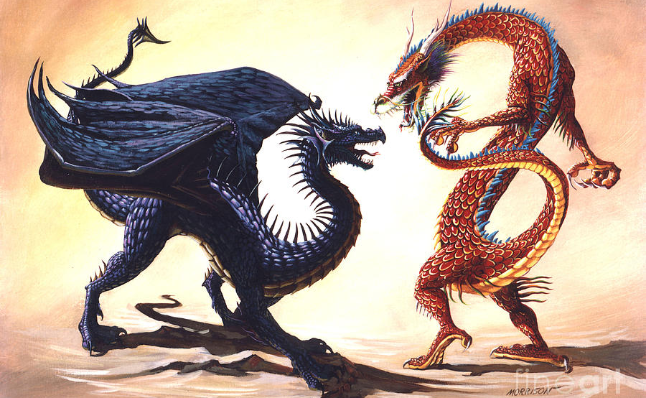
Global race towards AI adoption
Nations worldwide are mobilizing to harness the power of artificial intelligence given its massive potential to shape global competitiveness over the coming decades.
In this work, we analyze a dataset of $2.2$ million papers published between 1990 and 2019, whose discipline is specified as AI according to Microsoft Academic Graph.
We will focus on the impact of particular cities on the global AI research effort. We assign each paper to the city of the main affiliation of the last author.
In particular, we will be interested in a distinction between Eastern and Western cities in this regard.
B. AlShebli, E. Cheng, M. Waniek, R. Jagannathan, P. Hernández-Lagos, T. Rahwan. Beijing’s central role in global artificial intelligence research. Scientific reports (2022)

Slide 31
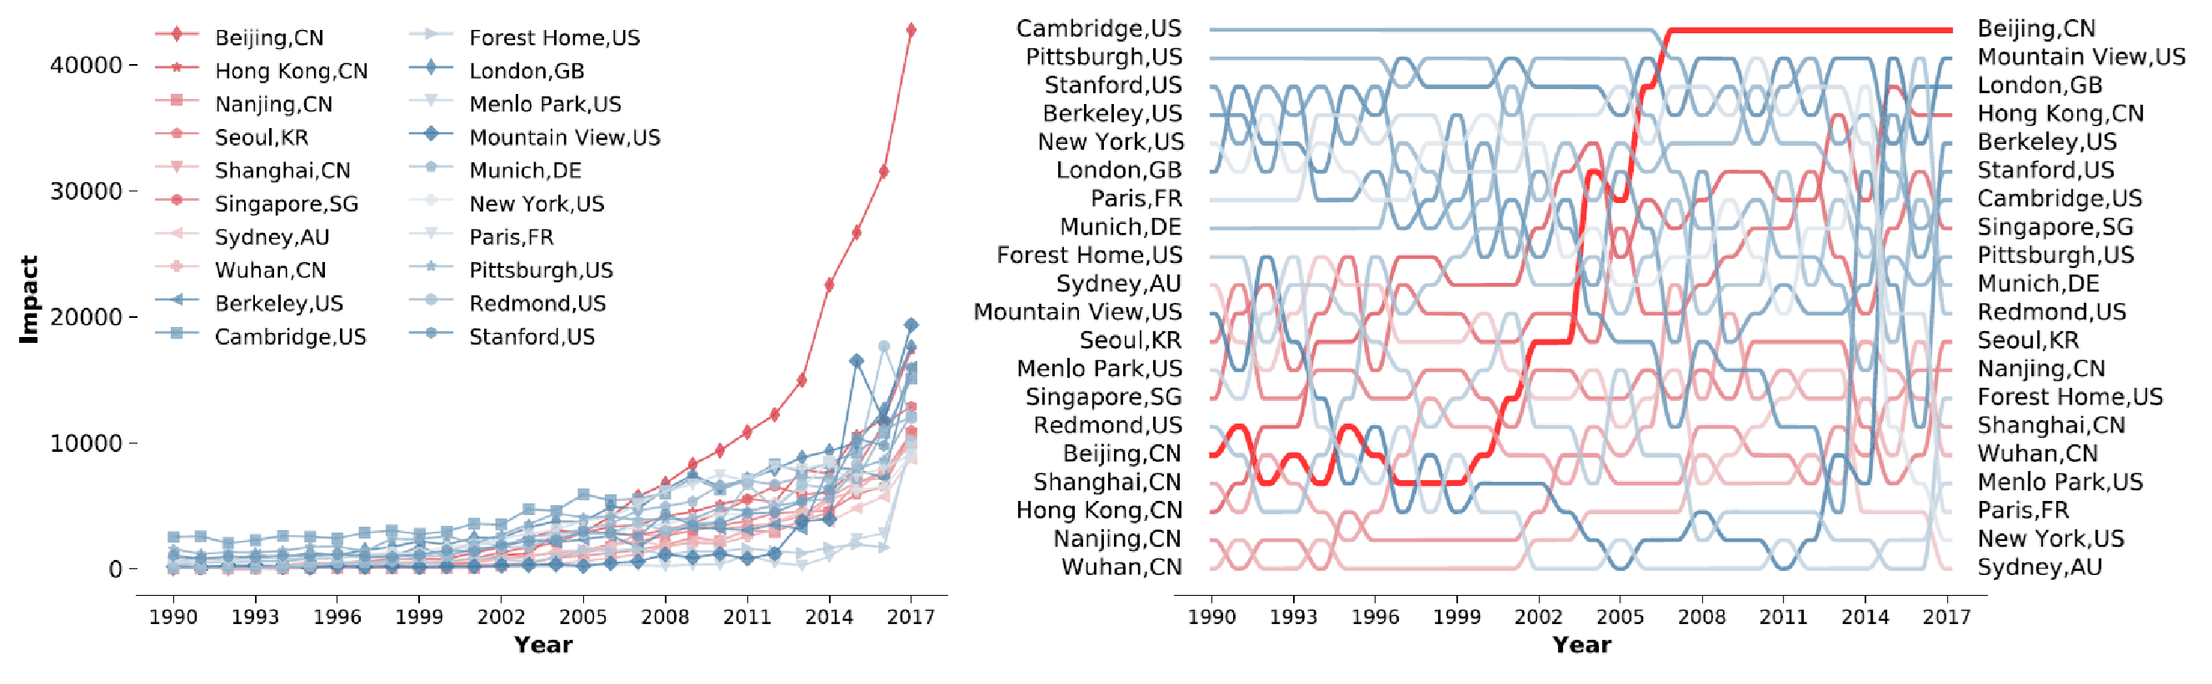
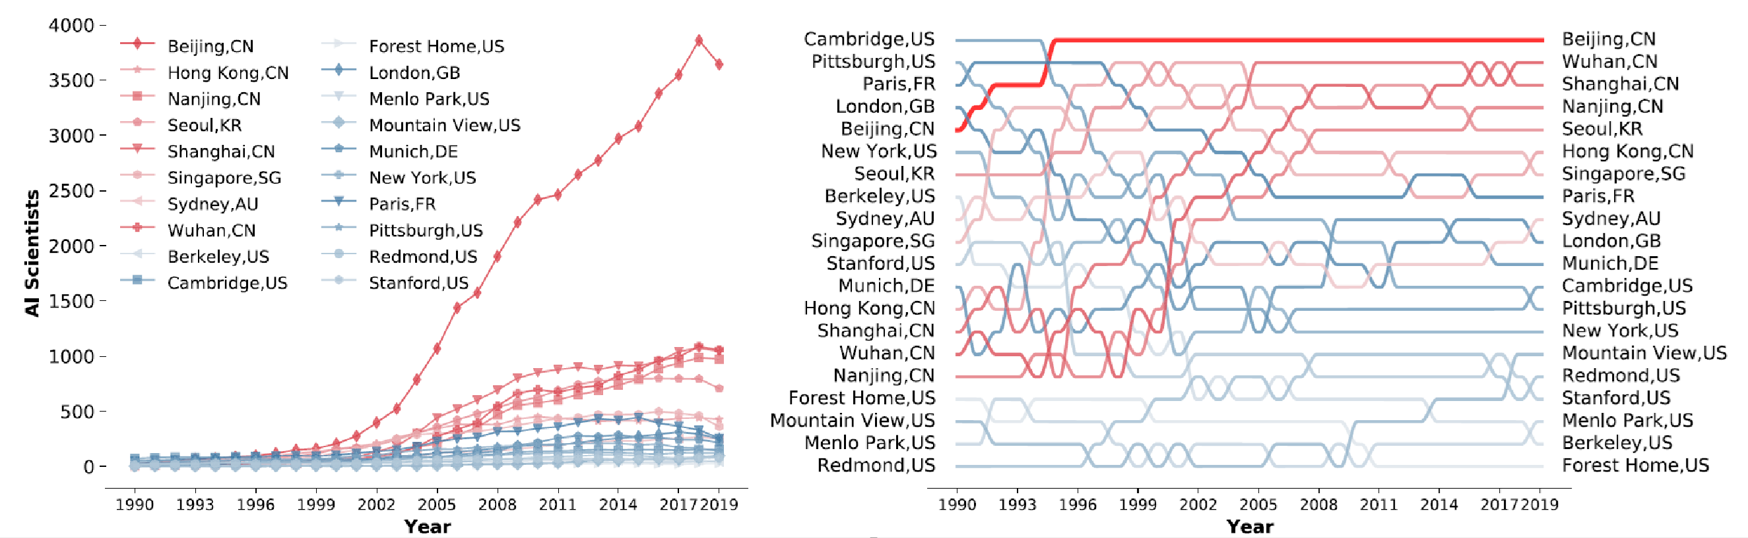
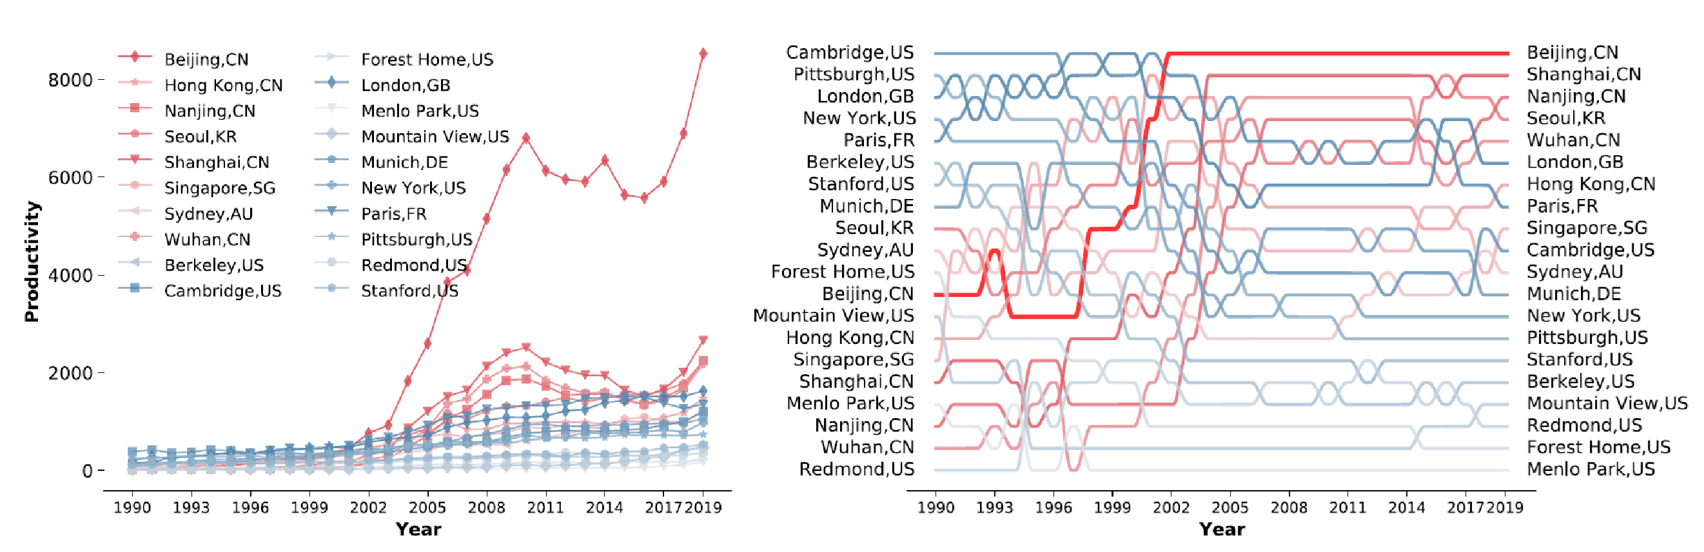
Top 20 AI cities
We first investigate what cities are crucial in AI research, noting whether they are East or West.
We assess them based on:
  Impact – total number of citations
  Productivity – total number of AI papers published
  AI scientists – the number of researchers affiliated with them
According to all three criteria, Beijing is the clear winner.
B. AlShebli, E. Cheng, M. Waniek, R. Jagannathan, P. Hernández-Lagos, T. Rahwan. Beijing’s central role in global artificial intelligence research. Scientific reports (2022)

Slide 32
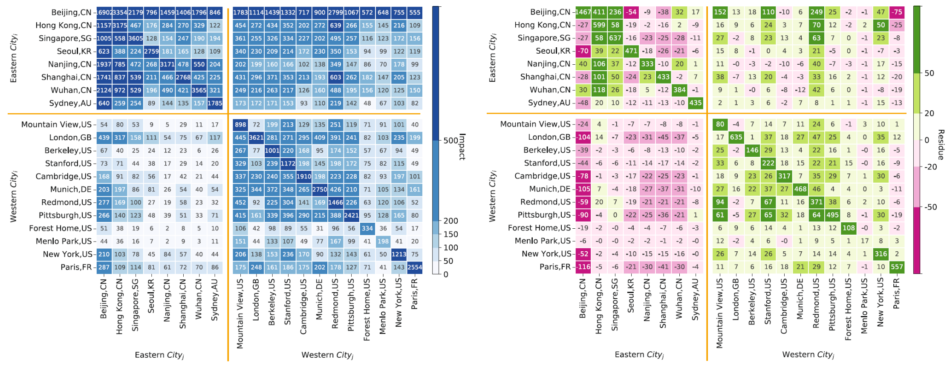
Citations between cities
We now analyze the structure of citations between cities.
Eastern cities seem to have relatively small impact on Western cities (except for Beijing).
Beijing cites all other top cities massively. Excluding citations to itself, 45% of its citations are to Eastern cities, and 55% are to Western ones, suggesting that builds on knowledge produced across the globe.
Each city cites itself heavily. This home bias is interesting given that communication technologies should, at least in principle, render distance ineffectual.
Findings are clear when we compare observed values with random citations.
B. AlShebli, E. Cheng, M. Waniek, R. Jagannathan, P. Hernández-Lagos, T. Rahwan. Beijing’s central role in global artificial intelligence research. Scientific reports (2022)

Slide 33
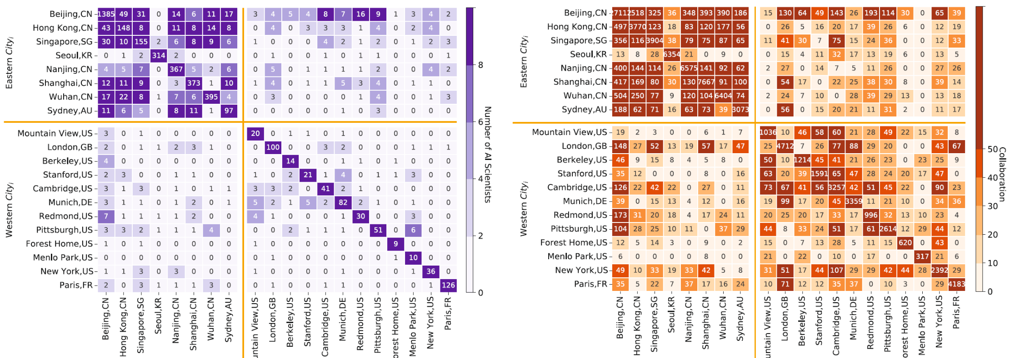
Migrations and collaborations between cities
We now analyze migrations of AI scientists.
Vast majority of AI scientists who were in any given city in 2015 remained in that city in 2019.
Most migration of AI scientists occurs between Eastern cities (except Seoul).
Beijing stands out as attracting and supplying the largest number of AI scientists.
We now switch the perspective to scientific collaborations between cities.
Both Eastern and Western cities collaborate frequently within their own clusters.
Beijing emerges as a hub, not only for Eastern cities but also for a few Western ones.
B. AlShebli, E. Cheng, M. Waniek, R. Jagannathan, P. Hernández-Lagos, T. Rahwan. Beijing’s central role in global artificial intelligence research. Scientific reports (2022)

Slide 34
East-West betweenness
From | To | Citations
Boston | Beijing | $$4$$
Paris | Boston | $$2$$
Paris | Beijing | $$10$$
Beijing | Boston | $$12$$
Beijing | Tokyo | $$3$$
Given that Beijing seems to have strong ties with both Eastern and Western cities, we try to quantify this effect using network analysis.
We construct a directed network between cities using reciprocal weights.
Let $E$ be the set of Eastern cities, and $W$ be the set of Western cities. The East-West betweenness of a node $v$ is then:
$\sum_{\begin{aligned}e∈E\backslash \{v\}, \\ w∈W\backslash \{v\}: \\ σ_{ew}>0\end{aligned}}{\frac{σ_{ew}(v)}{σ_{ew}}}+\sum_{\begin{aligned}e∈E\backslash \{v\}, \\ w∈W\backslash \{v\}: \\ σ_{we}>0\end{aligned}}{\frac{σ_{we}(v)}{σ_{we}}}$
where
  $σ_{st}$ is the set of shortest paths from $s$ to $t$
  $σ_{st}(v)$ is the set of shortest paths from $s$ to $t$ that run through $v$
Boston
Tokyo
$$\frac{1}{4}$$
$$\frac{1}{2}$$
$$\frac{1}{3}$$
$$\frac{1}{12}$$
$$\frac{1}{10}$$
Paris
Beijing
B. AlShebli, E. Cheng, M. Waniek, R. Jagannathan, P. Hernández-Lagos, T. Rahwan. Beijing’s central role in global artificial intelligence research. Scientific reports (2022)

Slide 35
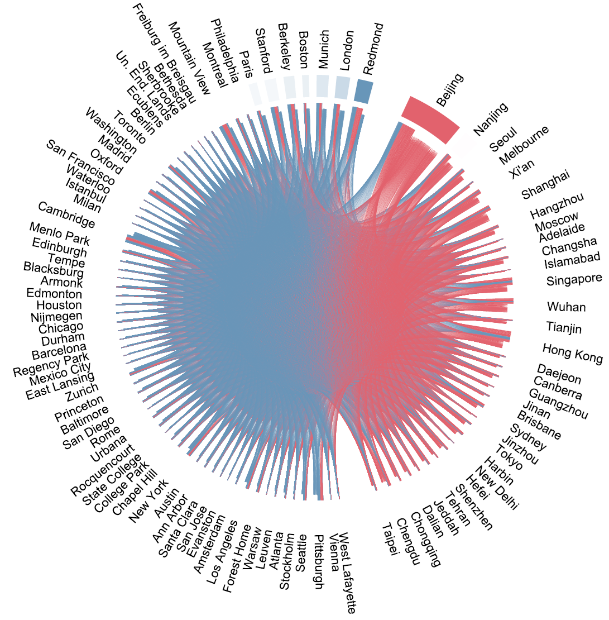
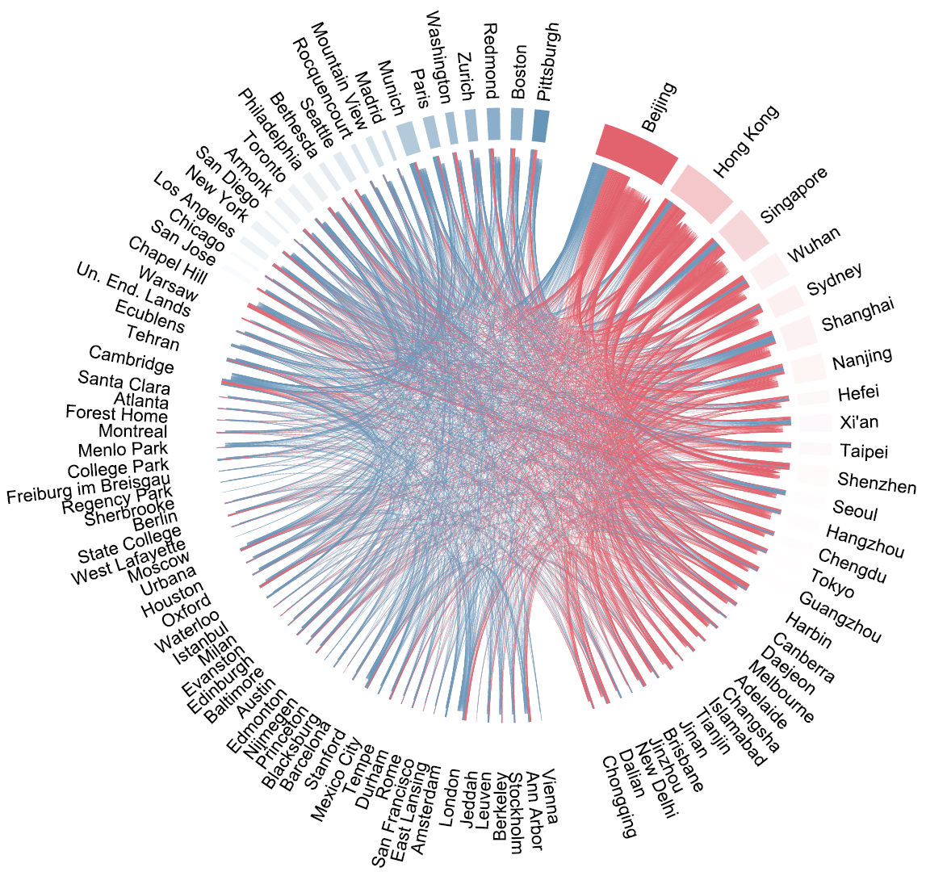
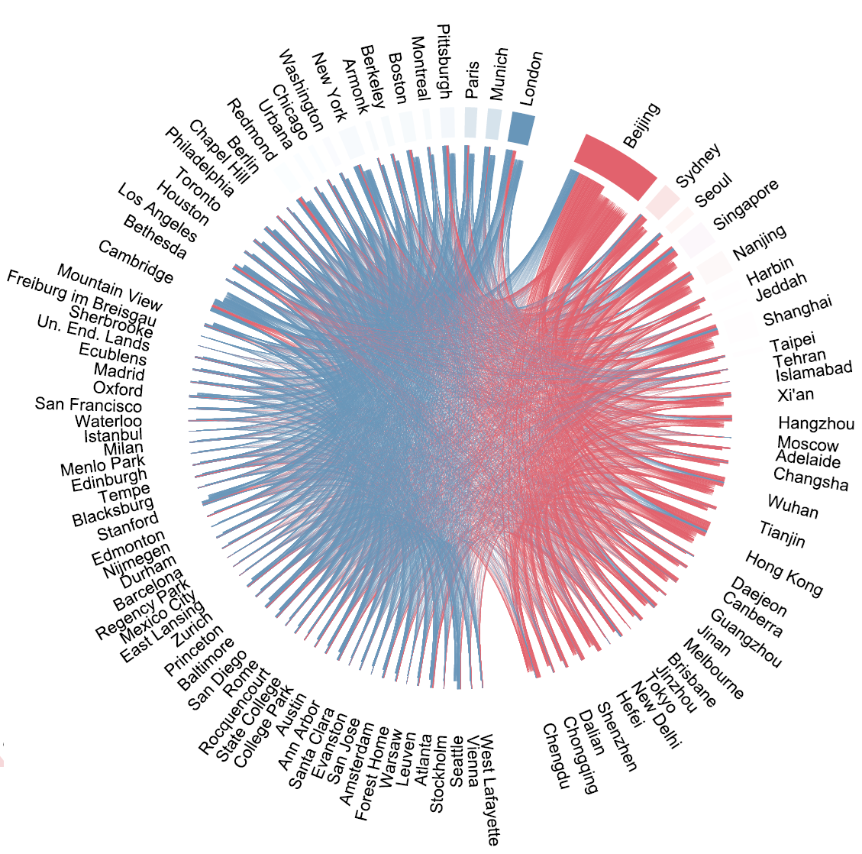
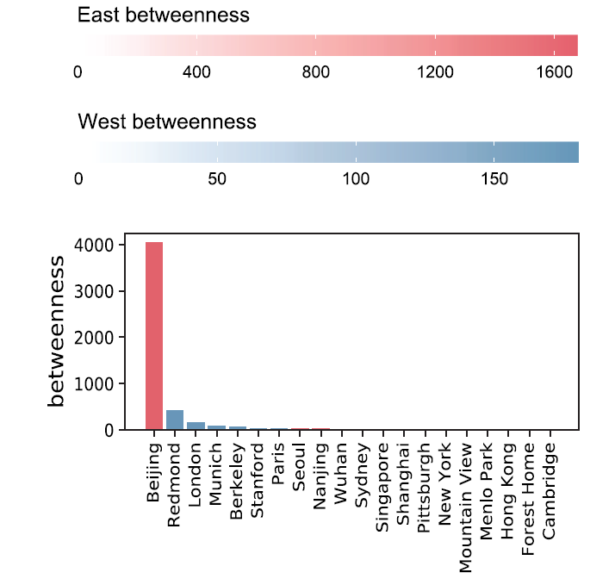
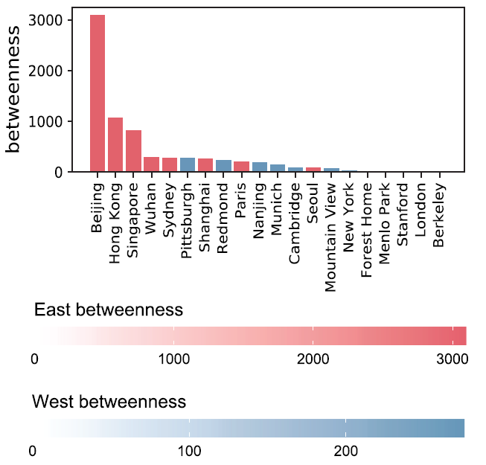
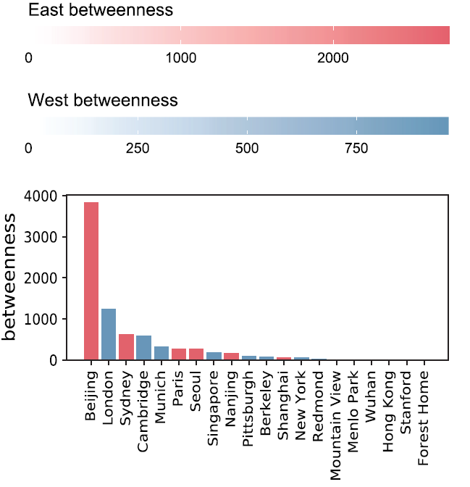
East-West betweenness results
Citation network
Migration network
We now visualize betweenness in our data.
Beijing plays a key role in transitioning knowledge between East and West.
It also acts as a hub through which AI scientists in the East can reach the West and vice versa.
It is also the city where Eastern and Western AI scientists most frequently share a co-author, effectively connecting both parts of the world.
In fact, in all three cases Beijing’s East-West betweenness value is greater than the combined centrality of all other cities in absolute terms.
Collaboration network
B. AlShebli, E. Cheng, M. Waniek, R. Jagannathan, P. Hernández-Lagos, T. Rahwan. Beijing’s central role in global artificial intelligence research. Scientific reports (2022)

Slide 36
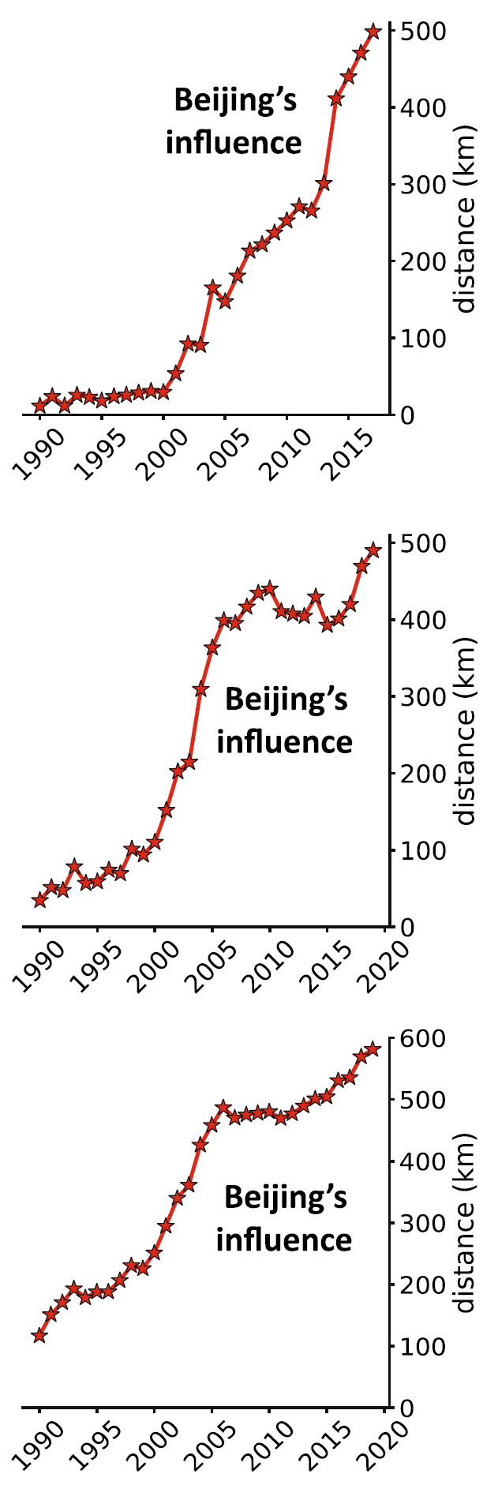
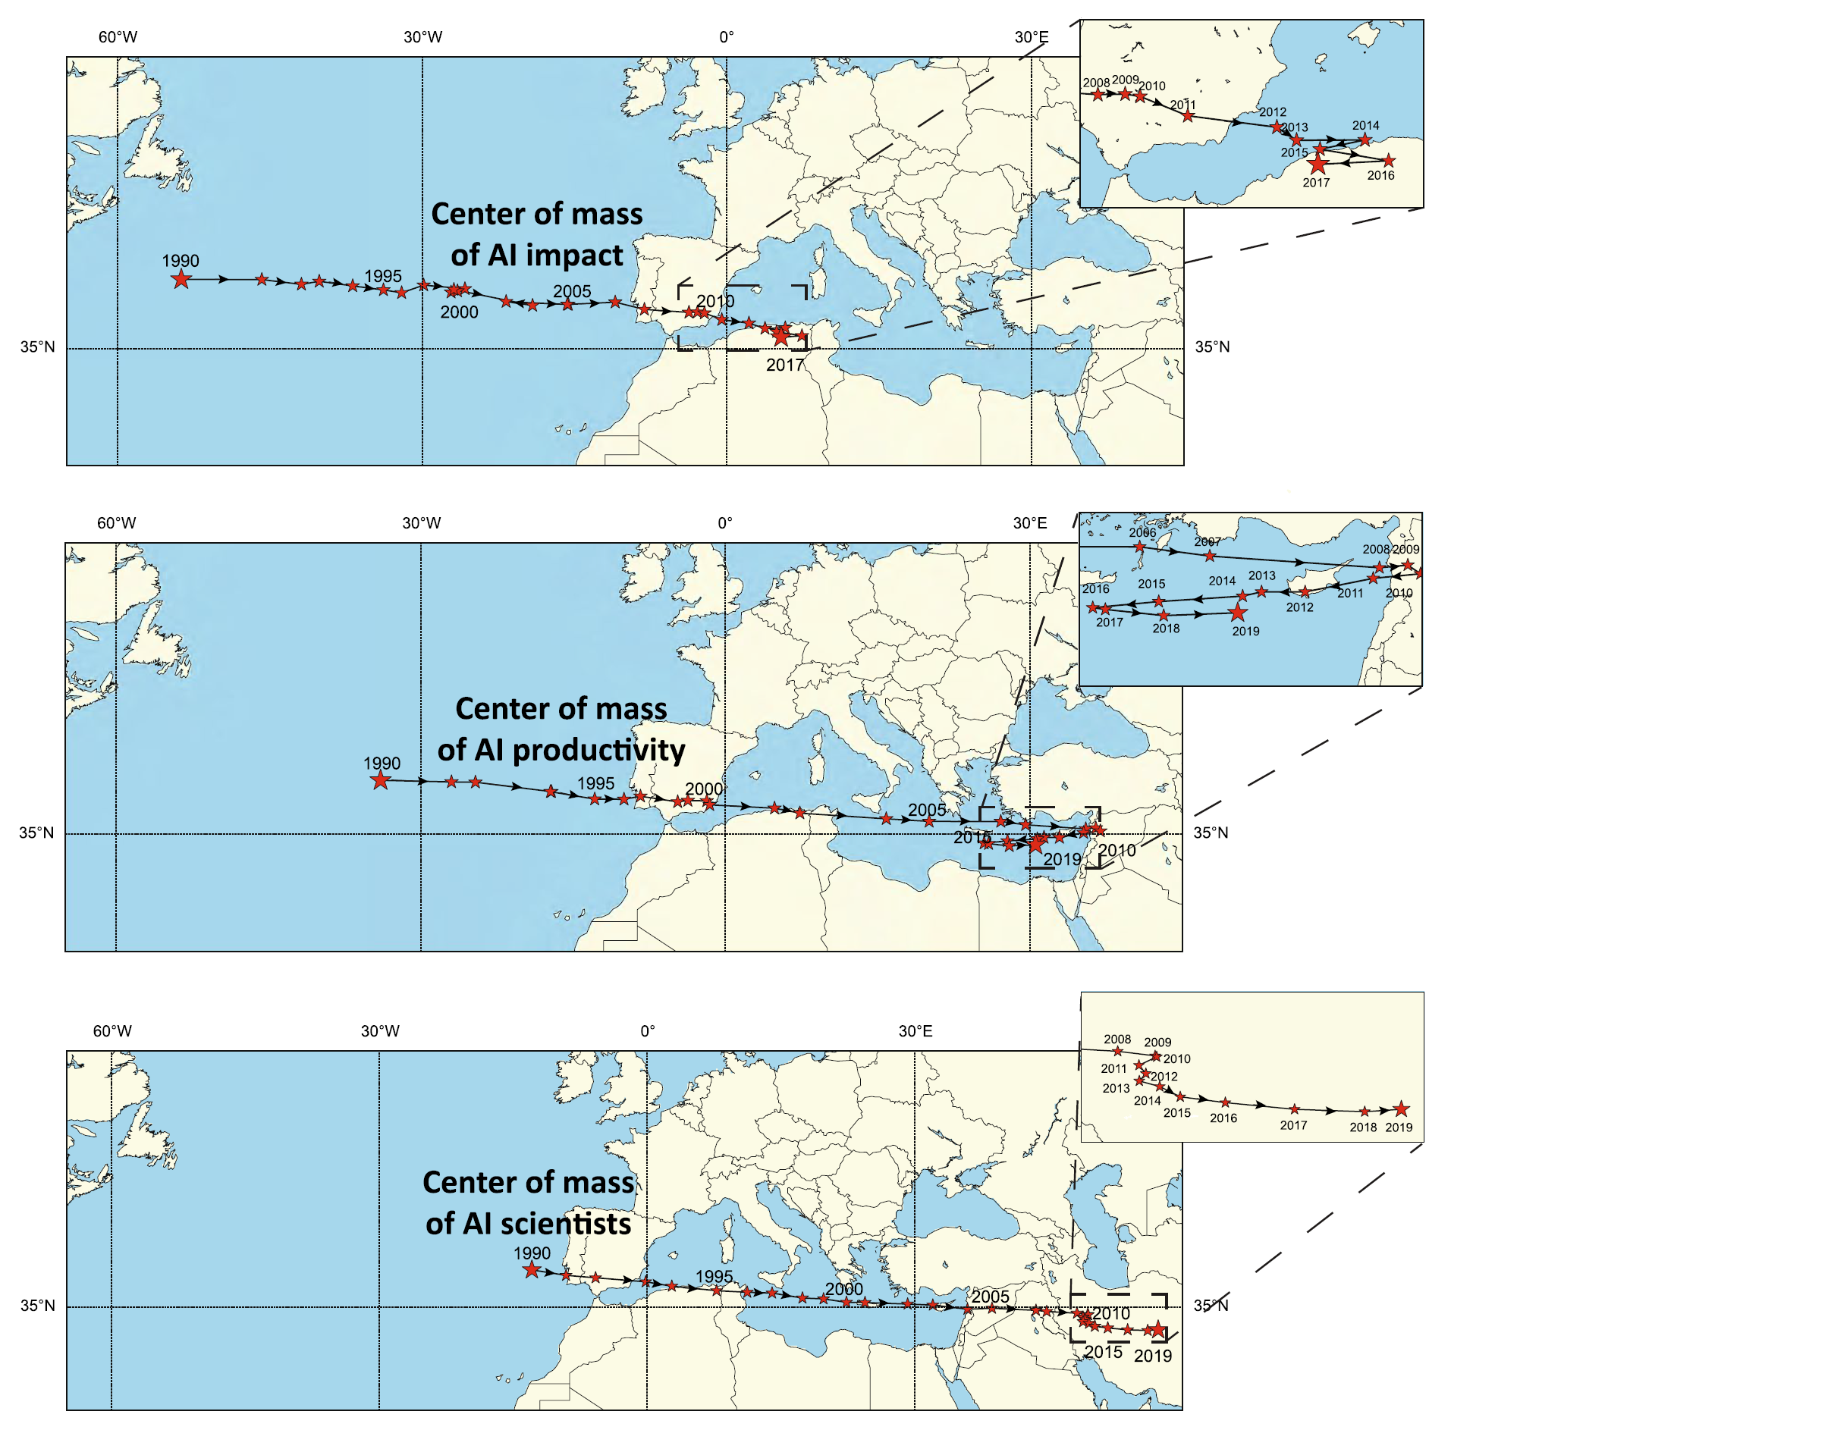
Center of mass analysis
We also perform the center of mass analysis, where each city is weighted with its characteristic (impact, productivity, or AI scientists), and we compute the location where forces are balanced for each year.
The center of mass tends to move eastwards over the thirty years of our dataset, according to all three considered characteristics.
What is more, Beijing’s gravitational pull has increased steadily over the years, reaching hundreds of kilometers annually.
B. AlShebli, E. Cheng, M. Waniek, R. Jagannathan, P. Hernández-Lagos, T. Rahwan. Beijing’s central role in global artificial intelligence research. Scientific reports (2022)

Slide 37




Project idea #3 Temporal network of scientists
2015,
2017-2023
2013-2016,
2018, 2019
Research question
How important events in a scientist’s career affect their centrality?
Bedoor AlShebli
New York University Abu Dhabi

Slide 38
Link prediction

Slide 39

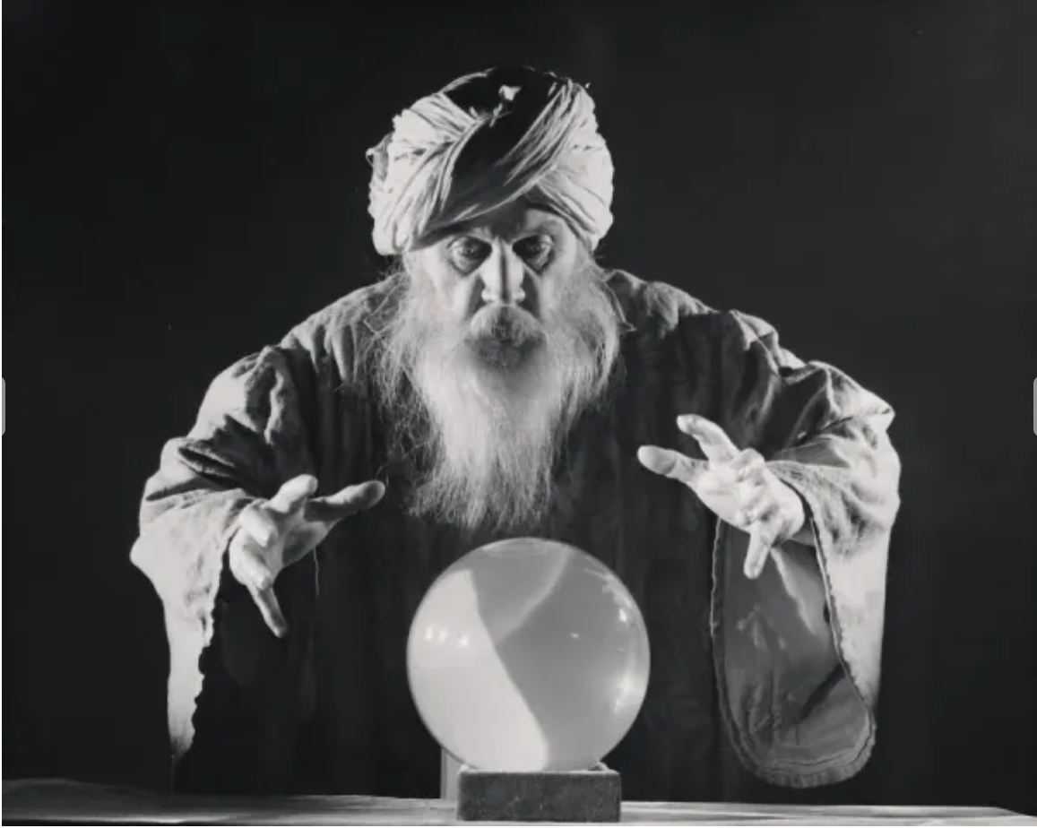

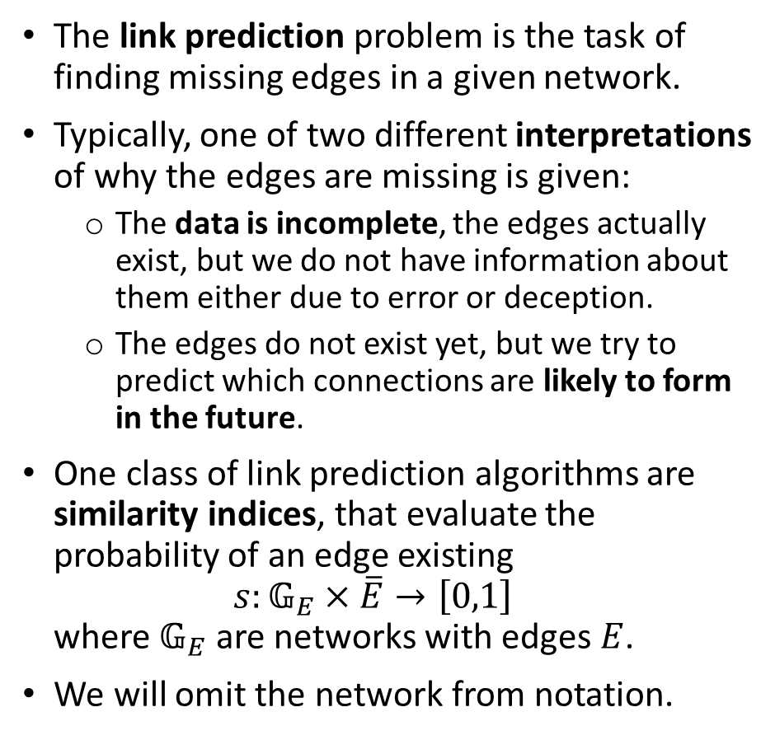

Link prediction problem
The link prediction problem is the task of finding missing edges in a given network.
Typically, one of two different interpretations of why the edges are missing is given:
  The data is incomplete, the edges actually exist, but we do not have information about them either due to error or deception.
  The edges do not exist yet, but we try to predict which connections are likely to form in the future.
One class of link prediction algorithms are similarity indices, that evaluate the probability of an edge existing
$s:𝔾_{E}×\overline{E}→\left[0,1\right]$
where $𝔾_{E}$ are networks with edges $E$.
We will omit the network from notation.
$$0.7$$
$$0.1$$

Slide 40
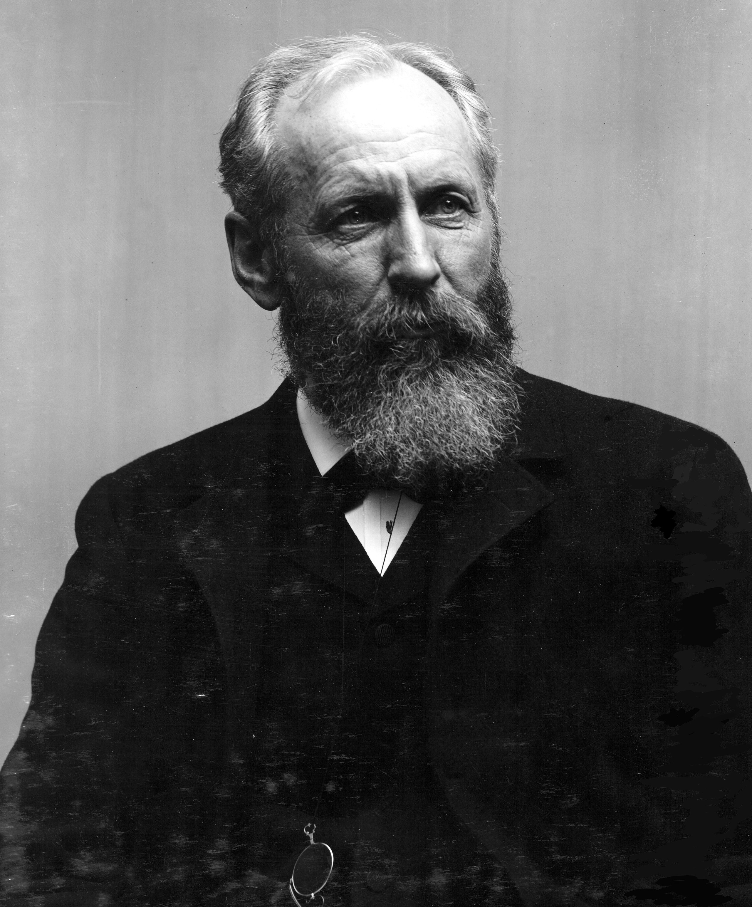



Local similarity indices
First, we will focus on the local similarity indices, i.e., similarity indices that in order to evaluate the similarity $s(v,w)$ of nodes $v∈V$ and $w∈V$ only use information about their neighborhoods $N\left(v\right)$ and $N(w)$.
All these indices are based in some way on the set of common neighbors
$N\left(v,w\right)=N\left(v\right)∩N(w)$
In particular, the Jaccard similarity index is an application of the intersection over union similarity of sets
$\frac{|A∩B|}{|A∪B|}$
independently developed by a geologist Grove Karl Gilbert (1884), and a botanist Paul Jaccard (1901).
Common neighbors $|N\left(v,w\right)|$
Salton $\frac{\left|N\left(v,w\right)\right|}{\sqrt{d\left(v\right)d(w)}}$
Jaccard $\frac{\left|N\left(v,w\right)\right|}{|N\left(v\right)∪N(w)|}$
Sorensen $\frac{2\left|N\left(v,w\right)\right|}{d\left(v\right)+d(w)}$
Hub promoted $\frac{\left|N\left(v,w\right)\right|}{min⁡(d\left(v\right),d(w))}$
Hub depressed $\frac{\left|N\left(v,w\right)\right|}{max⁡(d\left(v\right),d\left(w\right))}$
Leicht-Holme-Newman $\frac{\left|N\left(v,w\right)\right|}{d\left(v\right)d(w)}$
Adamic-Adar $\sum_{u∈N(v,w)}{\frac{1}{\log{(d(u))}}}$
Resource allocation $\sum_{u∈N(v,w)}{\frac{1}{d(u)}}$
P. Jaccard. Étude comparative de la distribution florale dans une portion des Alpes et des Jura. Bulletin de la Société vaudoise des sciences naturelles (1901)

Slide 41








Predicting protein interactions
The authors study the interactome, i.e., the network of human protein interactions.
As a first hypothesis, they test the Jaccard similarity for predicting interactions.
Unfortunately, it does not work at all. Multiple neighbors indicate that the protein bind to similar other protein.
Instead, focus on the number of $3$-paths (L3)
$s_{L3}\left(x,y\right)=\sum_{u,v}{\frac{a_{xu}a_{uv}a_{vy}}{\sqrt{\left|N\left(u\right)\right|\left|N\left(v\right)\right|}}}$
Longer paths do not work better.
Some interactions between protein involved in retinitis pigmentosa (type of progressive vision loss) predicted using the L3 method have been experimentally confirmed.
(average over top $1,000$ pairs)
I. Kovács et al. Network-based prediction of protein interactions. Nature communications (2019)

Slide 42
Community detection

Slide 43




Community detection and community structure
In the literature the term community is usually understood as a group of closely cooperating individuals.
Community detection algorithm is a method that:
  takes as an input the structure of a network $G=(V,E)$
  returns as an output a division of $V$ into communities.
This division of $V$ into communities is called a community structure.
It is usually assumed in the literature that communities in a community structure:
  cover the entire set of nodes
  are pairwise disjoint.
$$C_{2}$$
$$C_{3}$$
$$C_{1}$$

Slide 44









Modularity
It would be useful to have a method of evaluating the quality of a specific community structure.
Intuitively, what are the characteristics of a “good” community structure?
It seems that we would like to have more edges within the communities than edges between the communities.
The most popular measure is modularity
$$C_{2}$$
$$Q\left(CS\right)≈0.43$$
$$C_{3}$$
$$C_{1}$$
$$Q\left(CS\right)=\sum_{C_{i}∈CS}{\frac{\left|E\left(C_{i}\right)\right|}{\left|E\right|}−{\left(\frac{δ\left(C_{i}\right)}{2\left|E\right|}\right)}^{2}}$$
where:
$E(C_{i})$ are the edges between the nodes $C_{i}$
$δ(C_{i})$is the sum of degrees of the nodes in $C_{i}$
$$C_{1}^{′}$$
$$Q\left(CS^{′}\right)≈0.09$$
$$C_{2}^{′}$$
$$C_{3}^{′}$$

Slide 45
Hierarchical clustering and dendrogram
Many community detection algorithms are based on hierarchical clustering.
In a top-down version of the method, we start with all nodes in a single community.
Then, we iteratively divide one of the communities into two, until we reach a set of singletons.
In a bottom-up version of the method, we start with a set of singletons, and iteratively merge until we reach a grand coalition.
Afterwards, we select the best of the linear number of community structures (e.g., using modularity).
A
B
C
D
E
F
A
B
C
D
E
F
A
B
C
D
E
F
A
B
C
A
B
C
D
E
F
D
E
F
A
B
C
D
E
F
A
B
A
B
C
D
E
F
E
F
A
B
C
D
E
F
A
B
C
D
E
F
The solution is often represented as a dendrogram.

Slide 46

Girvan-Newman algorithm
Girvan-Newman community detection algorithm is an example of a hierarchical clustering top-down method.
To obtain the dendrogram for a connected network $G=(V,E)$:
  Begin with the coalition structure $CS_{0}=\{V\}$
  While $E$ is not empty:
    Remove from $e∈E$ with the greatest edge betweenness
    $\sum_{s,t∈V}{\frac{\left|π_{st}\left(e\right)\right|}{\left|π_{st}\right|}}$
    where:
      $π_{st}$ is the set of all shortest paths from $s$ to $t$
      $π_{st}(e)$ is the set of all shortest paths from $s$ to $t$ that run through $e$
    If the removal of $e$ disconnected a connected component, add the set of connected components to the dendrogram
A
E
C
D
B
F
A
B
C
D
E
F
A
B
C
D
E
F
A
B
C
D
E
F
A
B
C
D
E
F
A
B
C
D
E
F
A
B
C
D
E
F
M. Girvan, M. E. J. Newman. Community structure in social and biological networks. PNAS (2002)

Slide 47





Data-driven communities on Reddit
The authors study a network of Reddit communities (r/…), and cases where one community is mobilized by negative sentiment to comment in another.
An edge shows that a user in the source community making a cross-link to the target community. The sentiment labels are crowd-sourced.
Most community clusters have low negativity (blue), while controversial topics (e.g., r/conspiracy and r/theredpill) and advice communities generate many negative cross-links (red).
A small number of communities initiate the majority of conflicts.
Negative mobilizations may lead to “colonization”, where attackers become regular members of the target community.
S. Kumar, W. L. Hamilton, J. Leskovec, D. Jurafsky. Community interaction and conflict on the web. World wide web conference (2018)

Slide 48
Summary

Slide 49
Summary of the potential topics
Idea #1 Resistant centrality measures
Idea #2 Temporal aggregation
Idea #3 Temporal network of scientists
Marcin Waniek mjwaniek.com m.waniek@mimuw.edu.pl

